Slide 1
SSN COLLEGE OF ENGINEERING
Department of Information Technology
UIT2201 – Programming and Data Structures
2021 – 2022
A SYSTEM TO MANAGE THE OCCUPANCY OF A HOUSING COMMUNITY
IT B - BATCH B - GROUP 1 (98-102)

Slide 2
GROUP 1 - TEAM MEMBERS
S. SELCIA - 3122 21 5002 098
SHASHWAT SHIVAM - 3122 21 5002 099
V. SHASVAT VIJAY - 3122 21 5002 100
SHERWIN SATYA. A - 3122 21 5002 101
S. SHRIKAR - 3122 21 5002 102

Slide 3
PROBLEM STATEMENT
A newly established housing community association wants to develop a system to manage the occupancy of their community. The system should be able to generate a block-wise list of occupied and unoccupied houses. The details of the occupants should also be displayed based on their flat numbers. The system should display the availability of houses based on the BHKs for new clients and any new occupancy must be updated in the system. The system should also track the payment of monthly maintenance charges for all the occupied flats.

Slide 4
OBJECTIVES
To develop a system to generate a block-wise list of occupied and unoccupied houses.
The administrator must be able to view the block-wise list of occupied and unoccupied houses, details of the occupants with their block and flat numbers & maintenance fee status.
The occupants must be able to pay their monthly maintenance fee.
The new user must be able to create a new account to login.
The new user must also be able to view the details of the apartments i.e. occupancy, price and the type of BHK.

Slide 5
CLIENT DETAILS
NAME | MARY ANTONETTE
DATE OF BIRTH | 04.11.1982
PHONE NUMBER | 8778377419
ALTERNATE PHONE NUMBER | 9865979966
CONTRACT ACCEPTANCE DATE | 13.06.2022
EMAIL | groupod4@gmail.com
ADDRESS | 158 E 126th St, New York, NY 10035, United States
REFERRED BY | JEBICIA

Slide 6
REQUIREMENT ENGINEERING
Functional Requirements - ADMIN
SPRINT | EPIC | USER STORY# | USER STORY | ESSENTIAL/ DESIRABLE | DESCRIPTION OF THE REQUIREMENT
RS 1 | ADMIN | 1 | The admin should be able to view the details of all the members of the housing community | Essential | A window will be displayed showing the block no., house no., name, contact number and aadhaar number.
RS 2 | ADMIN | 2 | The admin should be able to view who all have paid the monthly maintenance fees | Essential | A column in the displayed window will contain whether monthly maintenance fees has been paid by the respective house
RS 3 | ADMIN | 3 | The admin should be able to send an intimation to all flat owners if they have not paid that month’s maintenance fee | Desirable | An automated message generation system can be built.

Slide 7
REQUIREMENT ENGINEERING
Functional Requirements - ADMIN
SPRINT | EPIC | USER STORY# | USER STORY | ESSENTIAL/ DESIRABLE | DESCRIPTION OF THE REQUIREMENT
RS 4 | ADMIN | 4 | As an admin, he must be able to see the occupancy status | Essential | A table displayed with a column showing Occupied if the details of the occupant is found, else not occupied
RS 5 | ADMIN | 5 | As an admin, the admin should be able to login only through the admin login | Essential | The username & password should be separate for admin.
RS 6 | ADMIN | 6 | As an admin he must be able to remove an occupant if he / she vacates the flat | Essential | The admin must enter the block and flat number which is to be vacated

Slide 8
REQUIREMENT ENGINEERING
Functional Requirements - OCCUPANT
SPRINT | EPIC | USER STORY# | USER STORY | ESSENTIAL/ DESIRABLE | DESCRIPTION OF THE REQUIREMENT
RS 7 | Occupant | 1 | As an occupant, the occupant should be able to login only through the occupant login | Essential | The username & password should be present in the separate login details
RS 8 | Occupant | 2 | The occupant should be able to view if monthly maintenance fees has been paid | Essential | A message box will be displayed showing monthly maintenance payment status .
RS 9 | Occupant | 3 | Occupant should be allowed to pay the monthly maintenance fee | Essential | The occupant must be able to pay either through UPI or net banking

Slide 9
REQUIREMENT ENGINEERING
Functional Requirements - NEW USER
SPRINT | EPIC | USER STORY# | USER STORY | ESSENTIAL/ DESIRABLE | DESCRIPTION OF THE REQUIREMENT
RS 10 | New User | 1 | The new user should be able to create an account & login | Essential | The password should have at least one digit, at least one character, @,+,-,_,., password must not exceed 8. Username must have 5 to 15 characters
RS 11 | New User | 2 | The new user can view the flat details | Essential | The new user will be able to view flat details, occupancy in a table displayed
RS 12 | New User | 3 | The new user should be able book flats they like | Essential | For booking a flat, buyer’s name, contact number, aadhaar number should be provided and then a confirmation message should be displayed saying initial process of booking is complete

Slide 10
INDIVIDUAL CONTRIBUTION - S. SELCIA
Team Lead / Scrum master
Helped the team in understanding, planning and advising all the scrum implementations by keeping the team on track & focussed.
A member of the development team.
Developed the admin module, occupant module, occupant payment module, new user creation module and flat booking module and worked with treeview tkinter to display contents.
Worked on all the login module implementations & designed the user interface for all modules present in the project.

Slide 11
INDIVIDUAL CONTRIBUTION - S. SELCIA
Helped in compiling the codes of team members, planning the sprints and deadlines for updating it in the Jira Confluence
Worked with Jira Confluence on objectives, roadmap, test cases, risk management, requirements and success metrics.
Managed json files and worked on powerpoint.

Slide 12
INDIVIDUAL CONTRIBUTION - SHASHWAT SHIVAM
Development Team Member
Worked in documenting the risk management and its corresponding mitigation plan in order to meet the deadlines, test cases, etc.
Helped in deciding deadlines and sprints with Shasvat for updating it in the Jira Software
Tested and made sure everything works before & after release.

Slide 13
INDIVIDUAL CONTRIBUTION - V. SHASVAT VIJAY
Responsible for prioritizing the backlog.
Worked in documenting the risk management and its corresponding mitigation plan in order to meet the deadlines, test cases, etc.
Tested and made sure everything works before & after release so that it meets the expectation of clients.
Worked on sprints, user stories and managing the product backlog.

Slide 14
INDIVIDUAL CONTRIBUTION - A. SHERWIN SATYA
Development Team Member
Helped in displaying the contents of the occupants on the window.
Collected requirements from clients
Worked on sprints, user stories in the Jira Software & powerpoint presentation.

Slide 15
INDIVIDUAL CONTRIBUTION - S. SHRIKAR
Stakeholder
Helped the scrum team by sharing feedback and ideas.
Worked on powerpoint presentation in displaying outputs.
Tested and made sure everything works before & after release.

Slide 16
IMPLEMENTATION DETAILS
This system has three login modules where-in each module has a different functionality.
ADMINISTRATOR MODULE - only the system administrator will be able to login through this module.
OCCUPANT MODULE - only the occupants who’ve already bought the house & are residing in it will be able to login through this module.
NEW USER MODULE - this module will allow the user to create an account if he doesn’t have one and allows him to login if he’s an existing user.

Slide 17
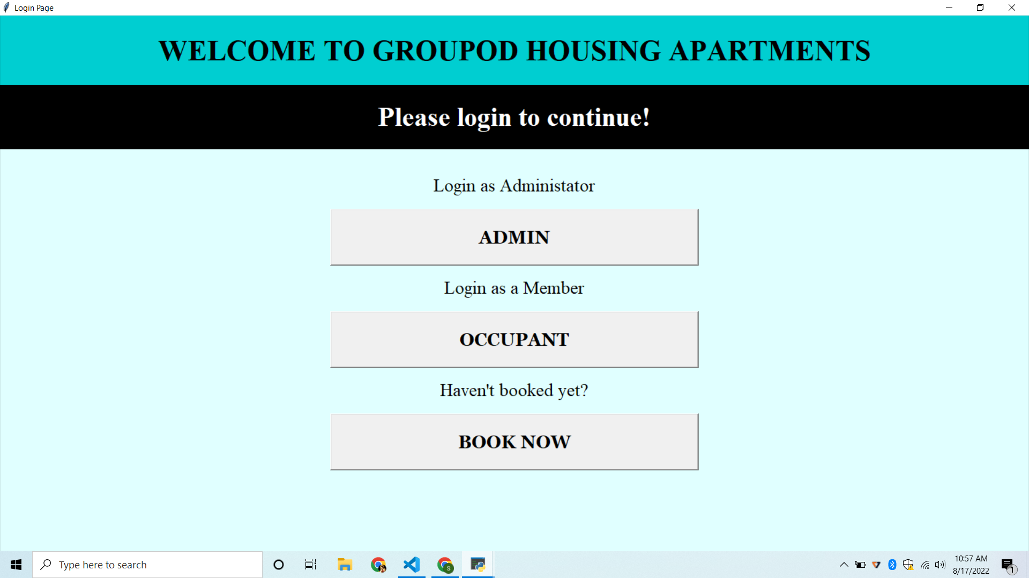

Slide 18
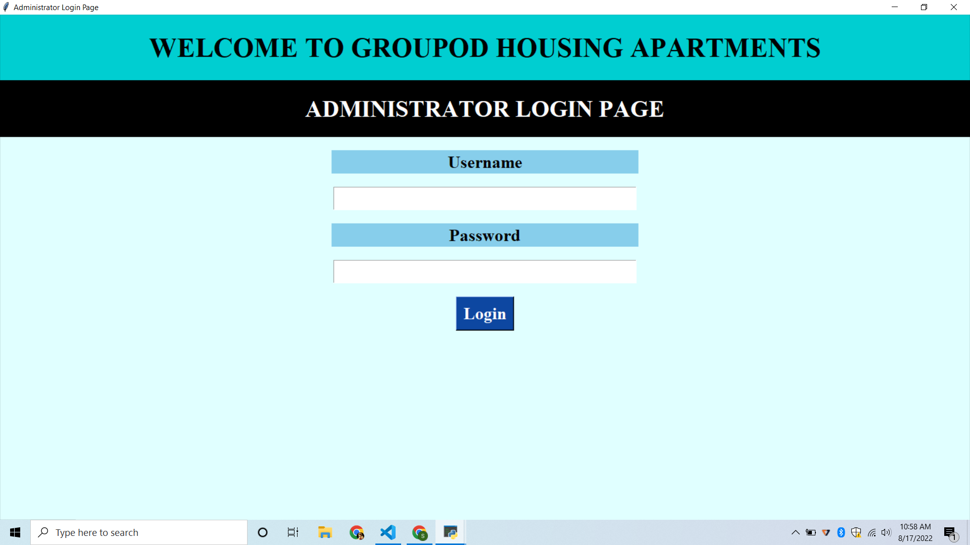

Slide 19
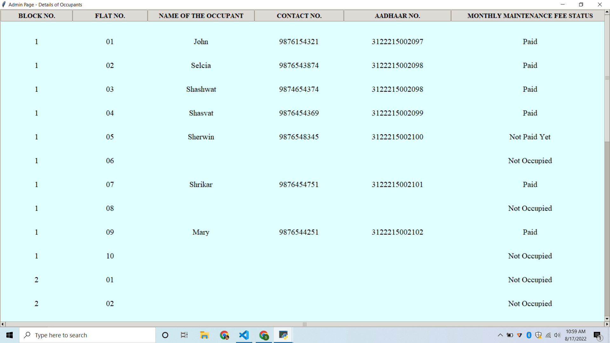

Slide 20
IMPLEMENTATION OF ADMIN MODULE
Here’s a list of block wise list of flat numbers with the occupant details, flat number, block number, name, mobile number and state of occupancy.
Once the system administrator logins, he’ll be able to view the details as mentioned above.
He can view the details of the occupants’ payment status as well.
Thus the system can generate a block wise list of occupant details which will make it easy for the administrator to manage the housing community.

Slide 21
JUSTIFICATION
With Python as a backend and Tkinter as the frontend this module was developed.
First we validate the admin’s login and allow the administrator to view the client details
Here we’ve used tkinter’s module named Treeview tkinter to establish a table with all the required content.

Slide 22
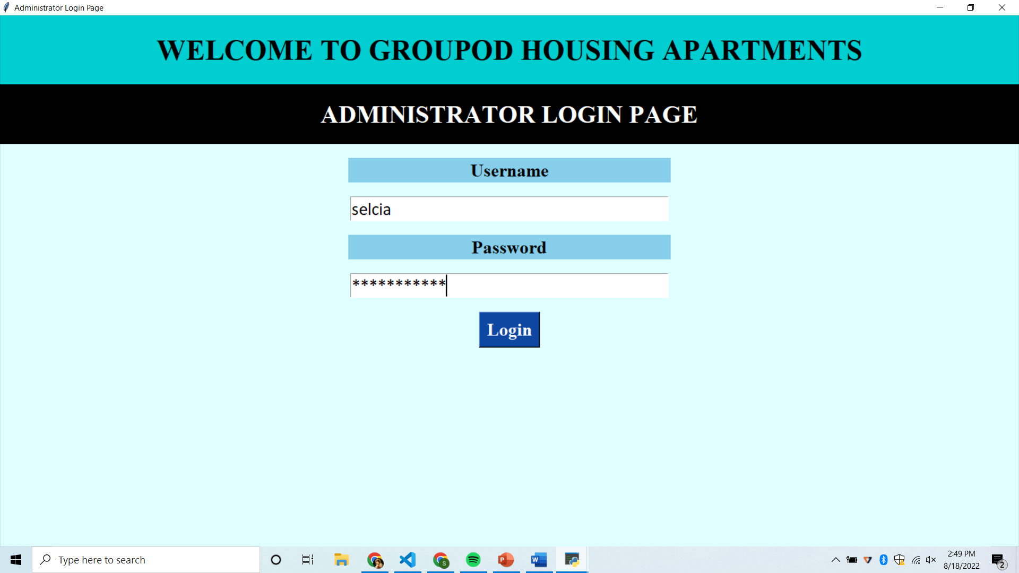
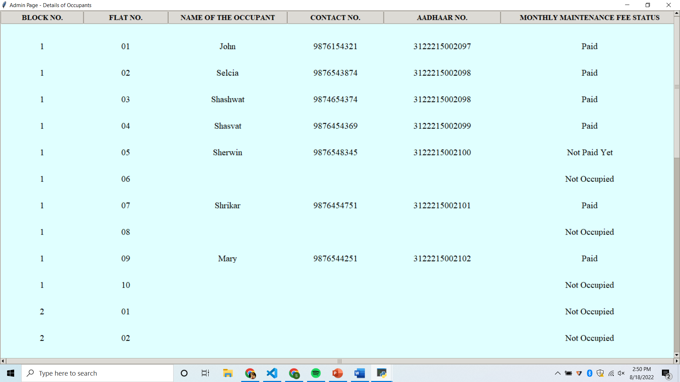
Test case - Admin Login
Passed
If entered username and password is correct - A window with the details of the occupants is popped up

Slide 23
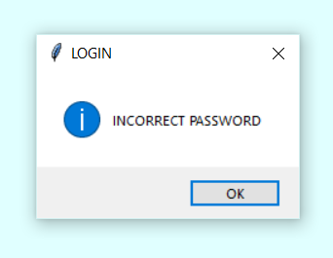
Test case - Admin Login
Passed
If entered username is correct and password is incorrect - A window showing a pop-up message “INCORRECT PASSWORD” is popped up

Slide 24


Test case - Admin Login
Passed
If entered username is incorrect and password is correct - A window showing a pop-up message “INVALID USERNAME” is popped up

Slide 25
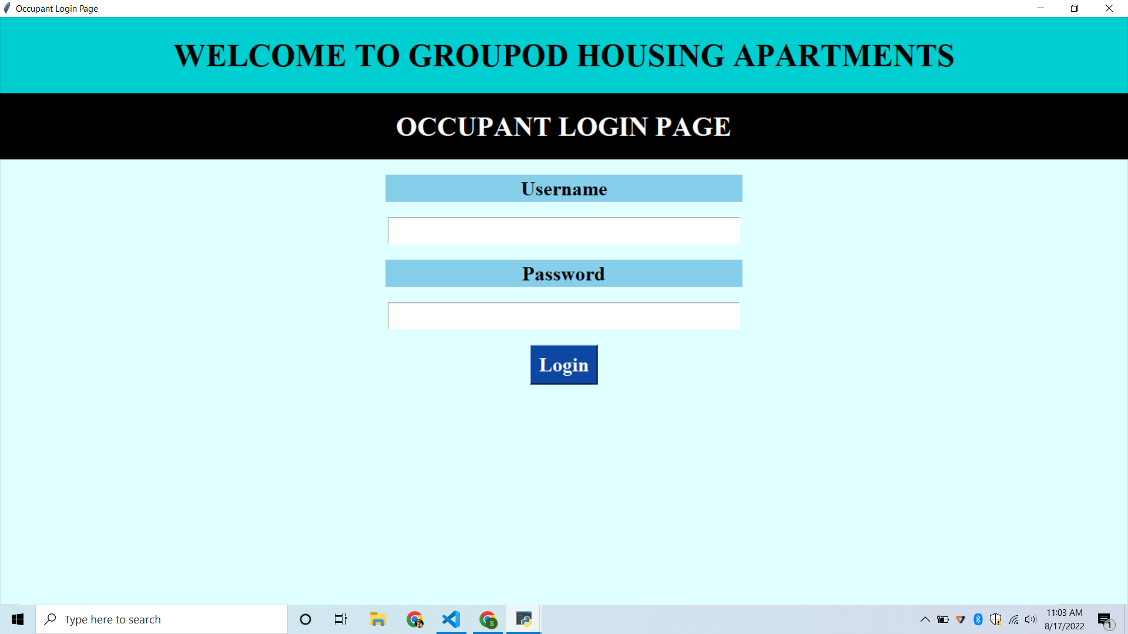

Slide 26
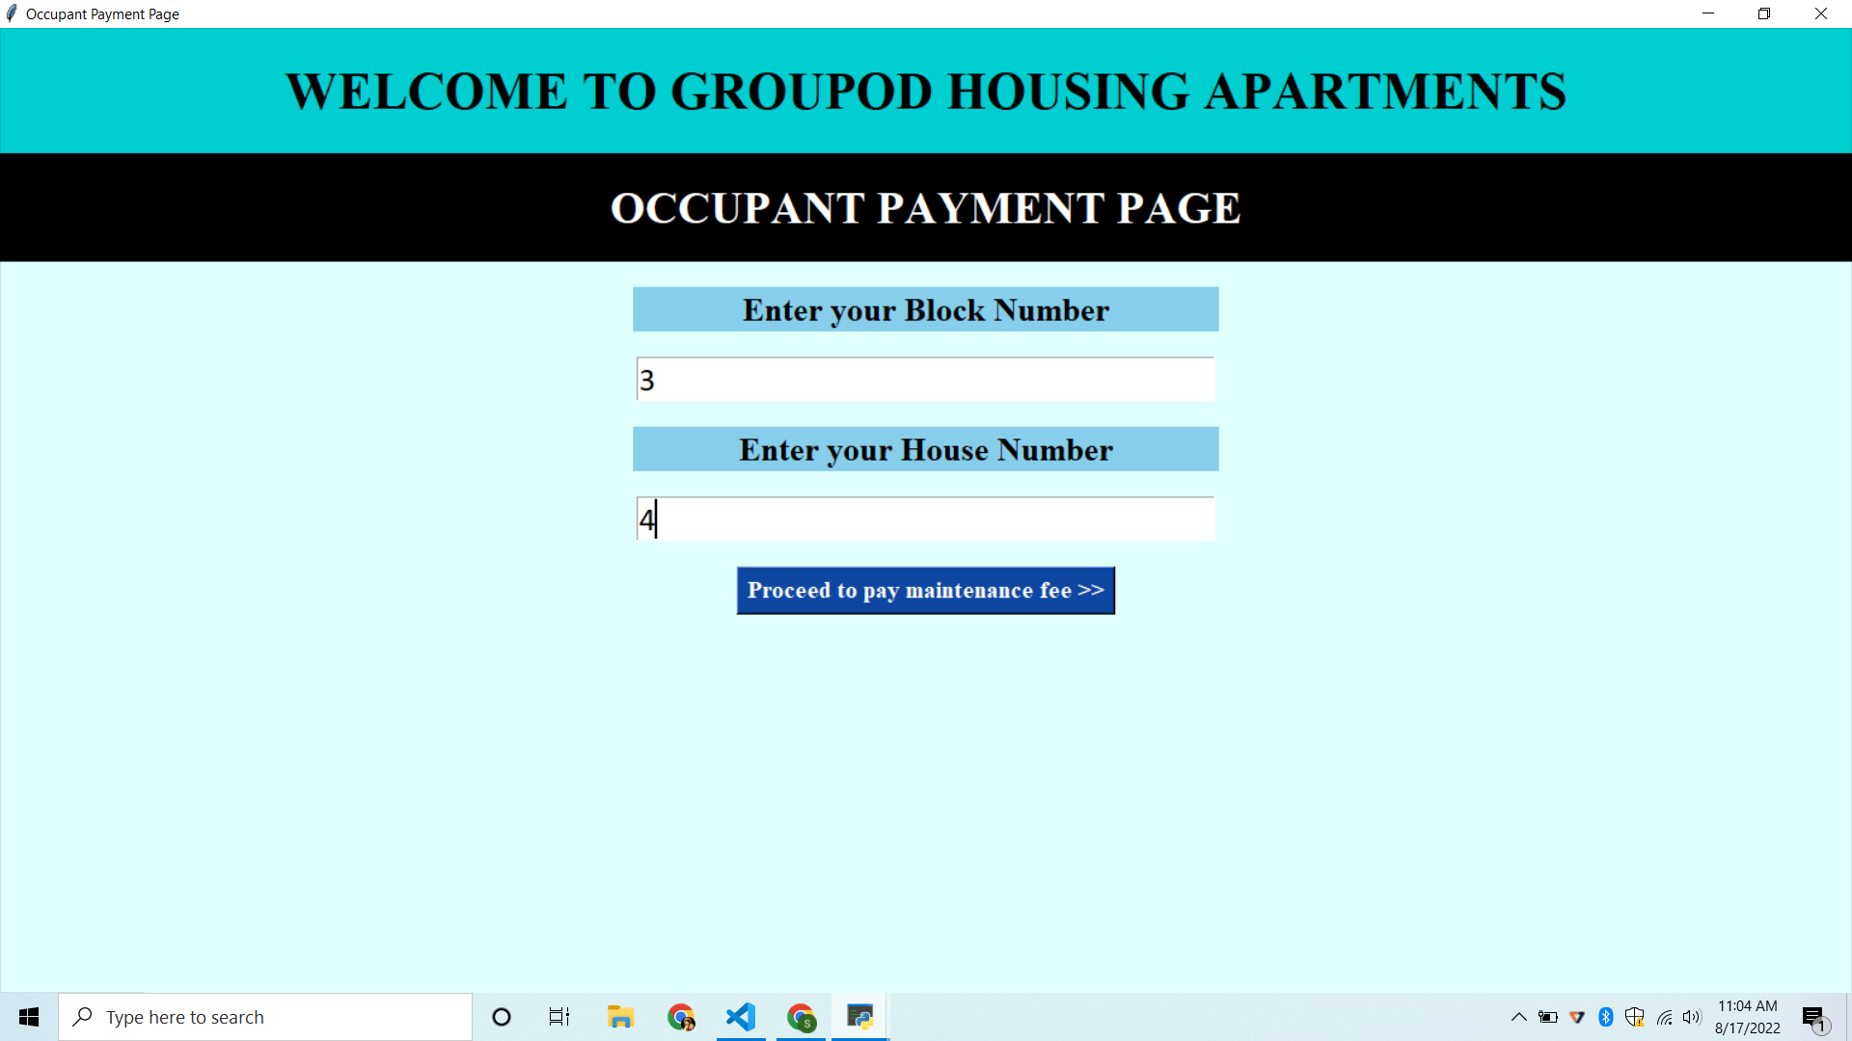

Slide 27
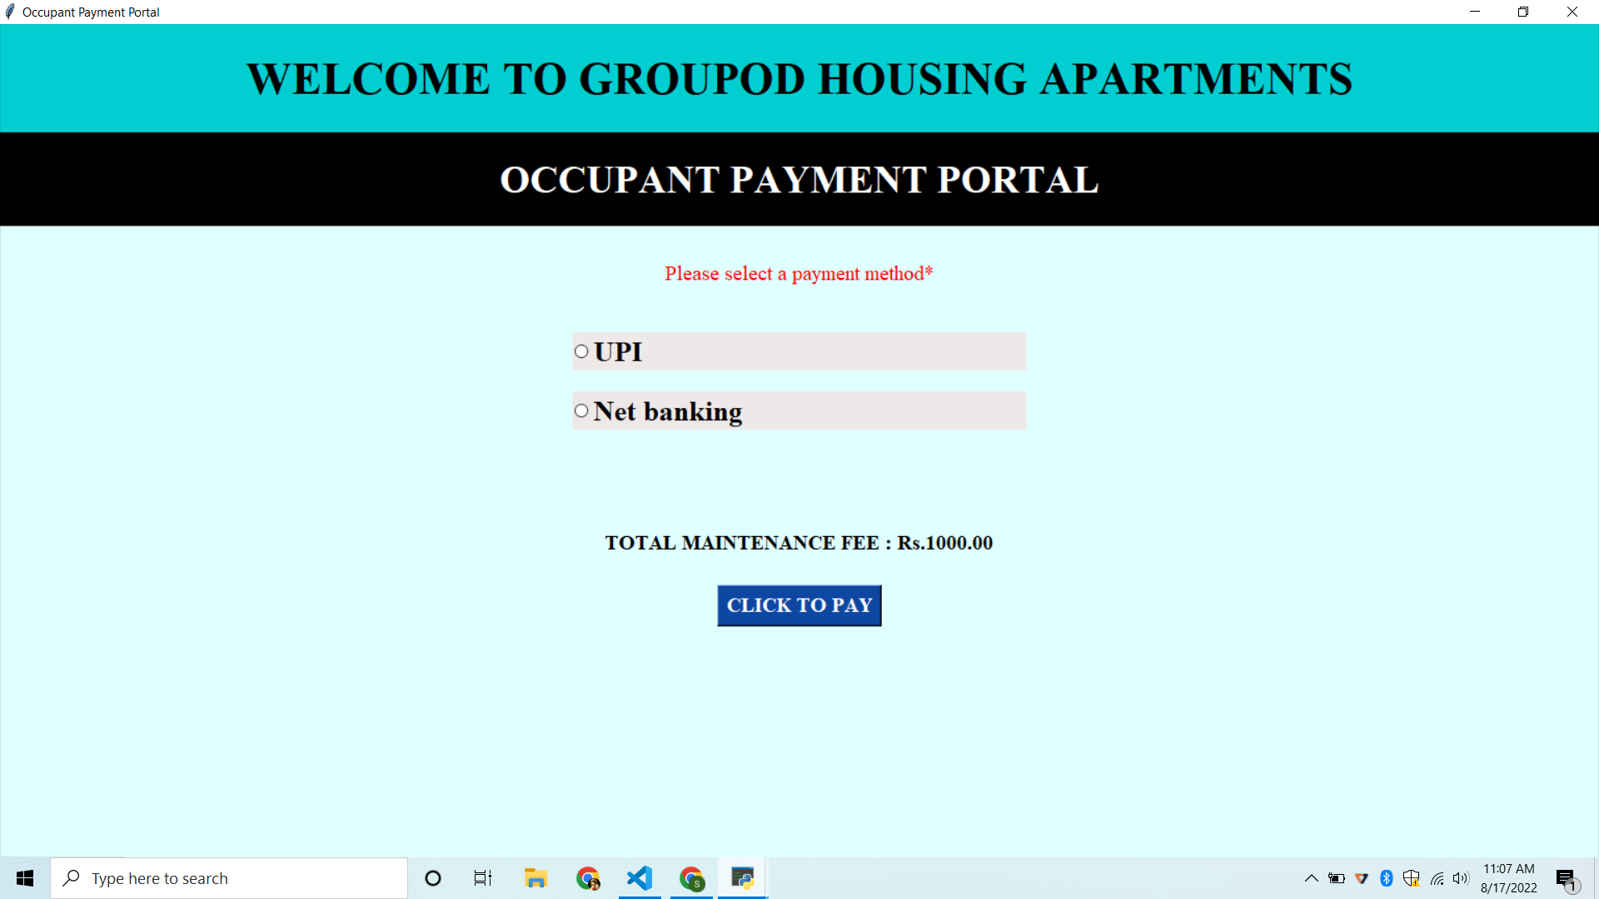

Slide 28
IMPLEMENTATION OF OCCUPANT MODULE
Once the system occupant logins, he’ll be asked to give his block number and flat number.
If the entered flat number and block number is correct then the payment portal will be opened.
Then the occupant will be asked to select the payment option to proceed further.
The payment will be successful when the occupant clicks the “Click To Pay” button.

Slide 29
JUSTIFICATION
With Python as a backend and Tkinter as the frontend this module was developed.
First we validate the occupant’s login and allow the occupant to enter his flat and block number
Here we’ve made two payment options - UPI and Netbanking for the customers to pay their monthly maintenance fee at ease.

Slide 30
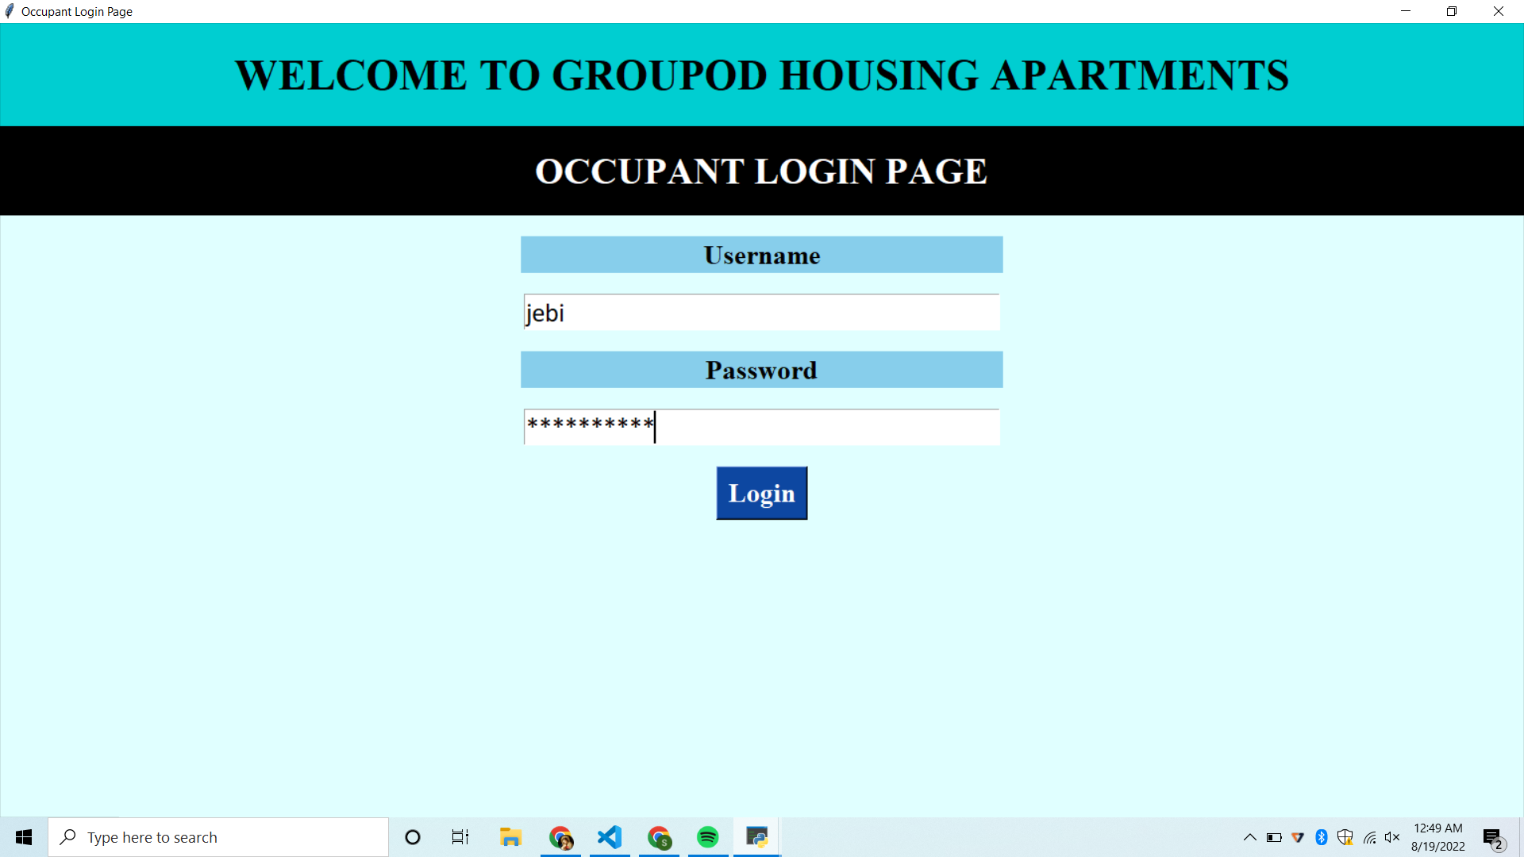
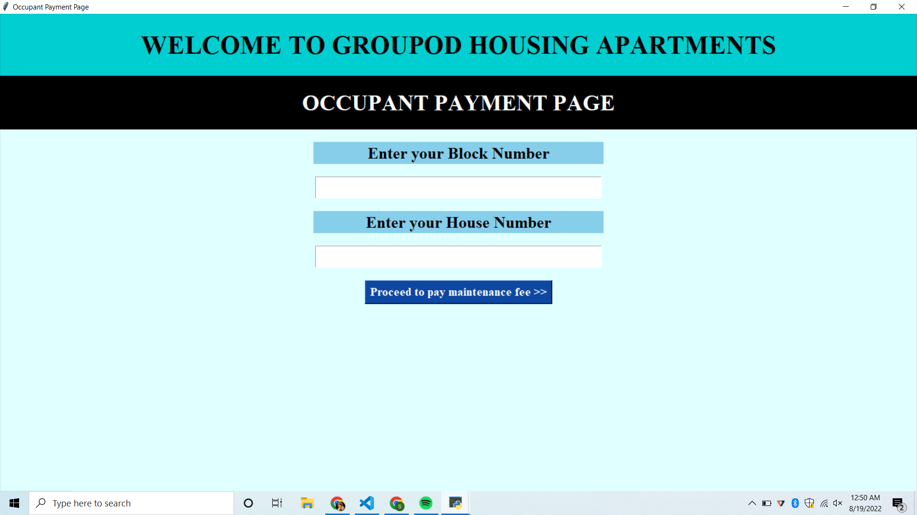
Test case - Occupant Login
Passed
If entered username and password is correct - A window showing an occupant payment page is popped up

Slide 31

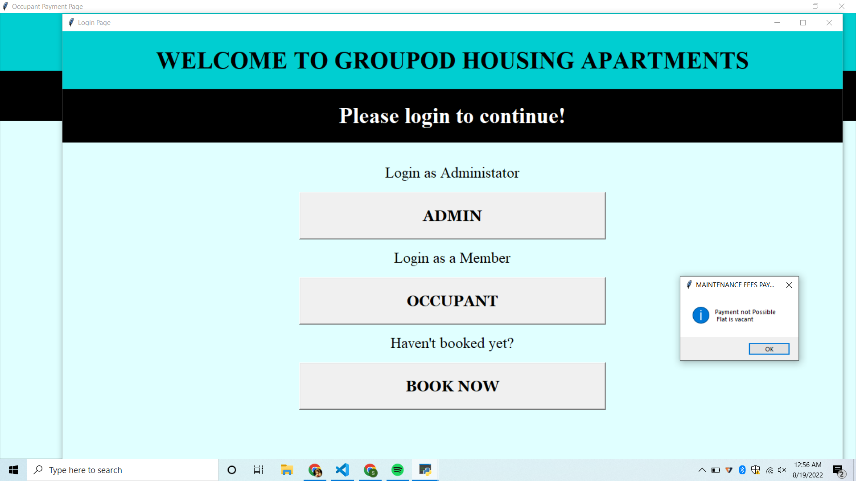
Test case - Occupant Payment
Passed
If entered a block number and flat number which is vacant - A window “Payment not Possible Flat is vacant” is popped up

Slide 32

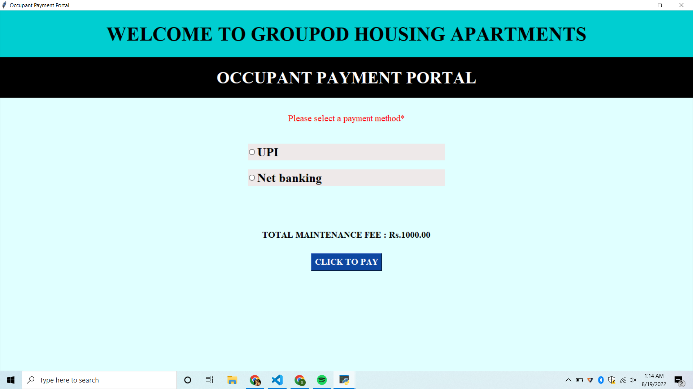
Test case - Occupant Payment
Passed
If entered block number and flat number is correct - A window asking for a payment option is popped up

Slide 33
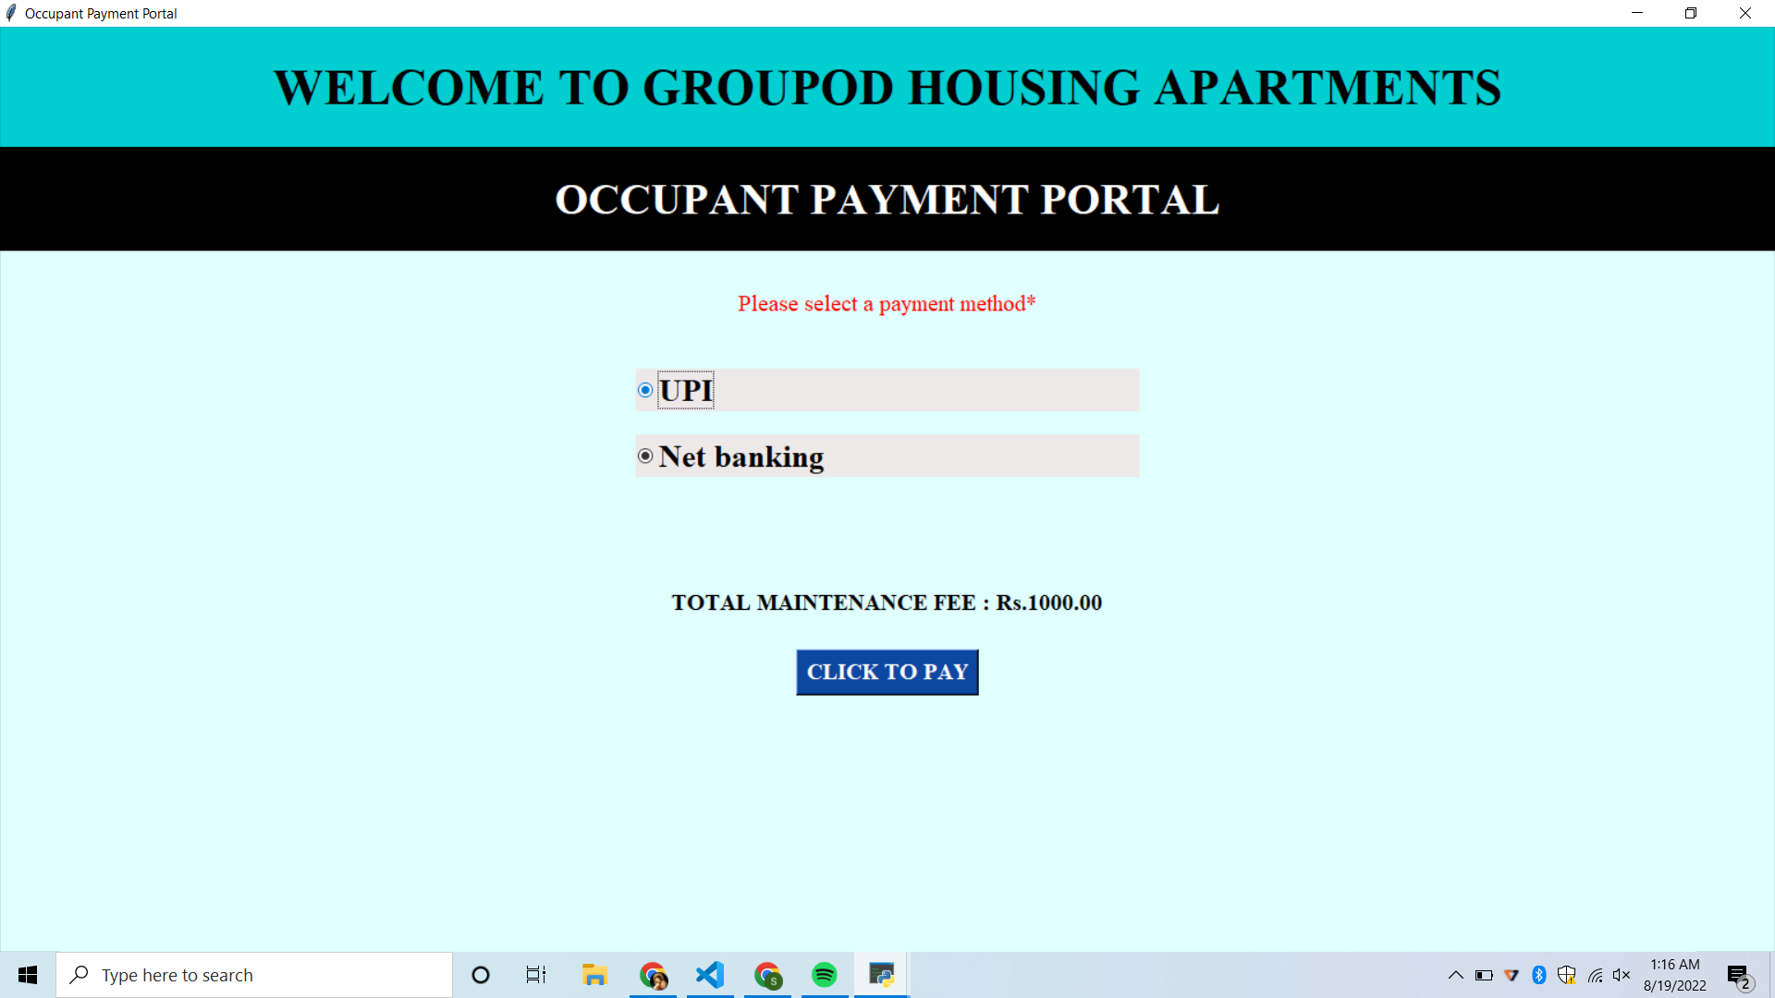
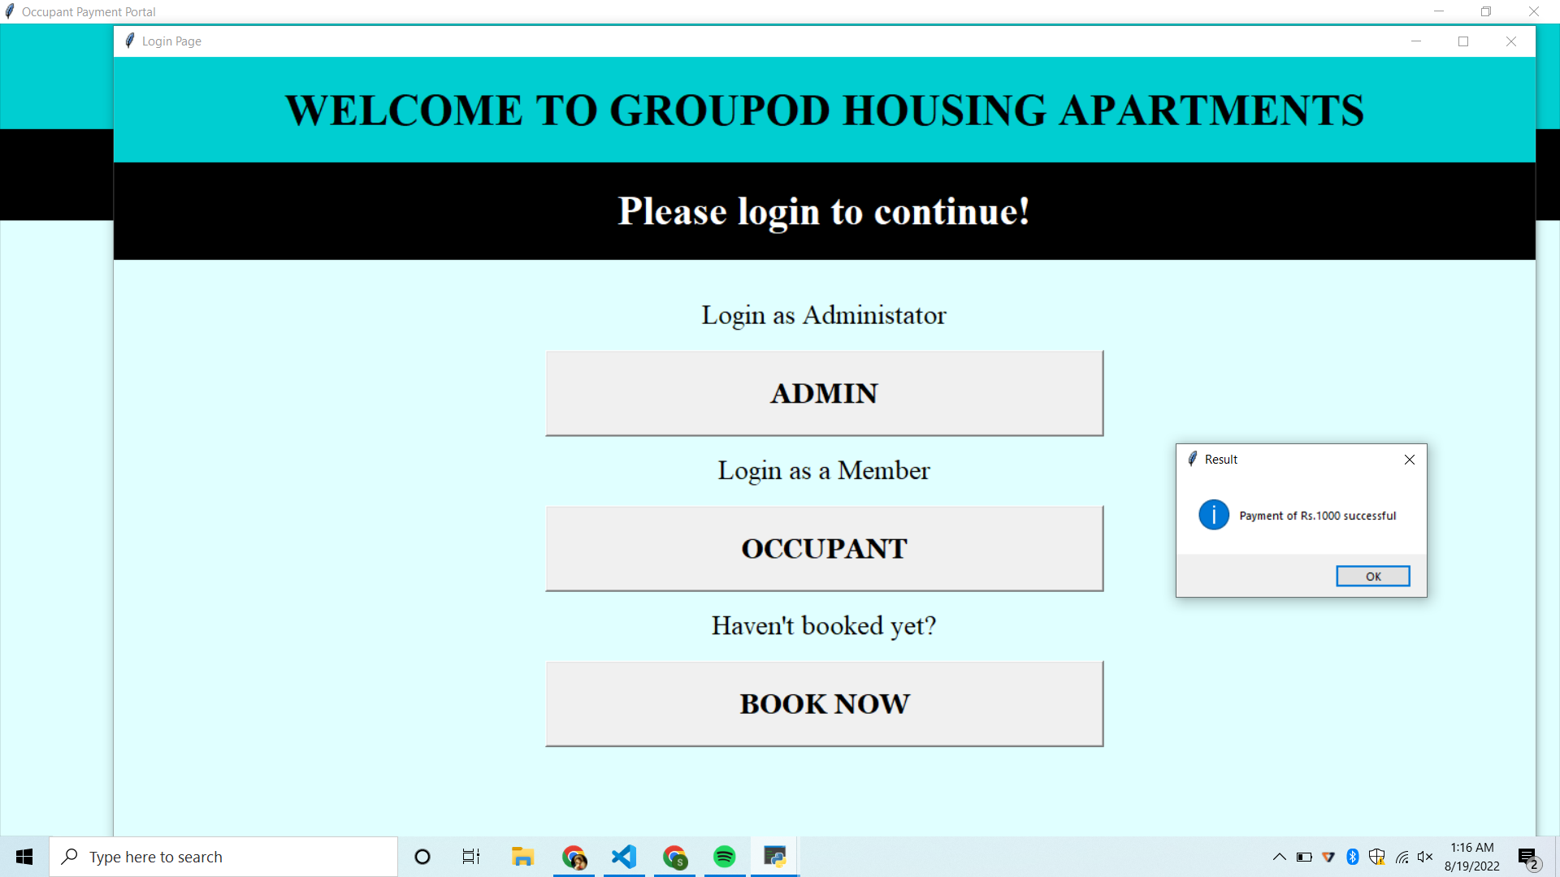
Test case - Occupant Payment
Passed
When an option is selected i.e. either UPI or Netbanking, and the “CLICK TO PAY” button is clicked, the payment is successful. A window “Payment of Rs.1000” successful is popped up

Slide 34
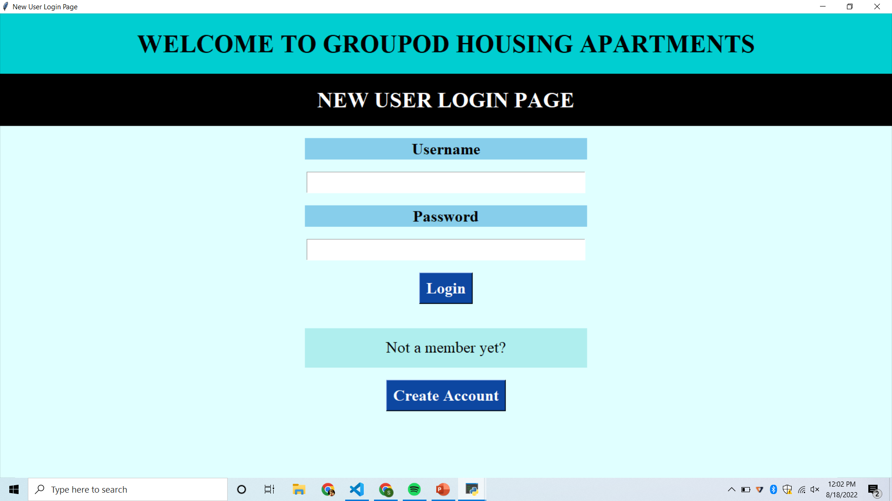

Slide 35
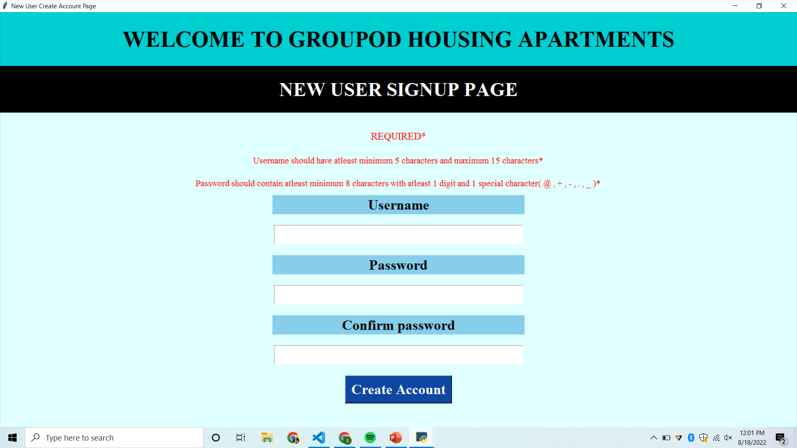

Slide 36
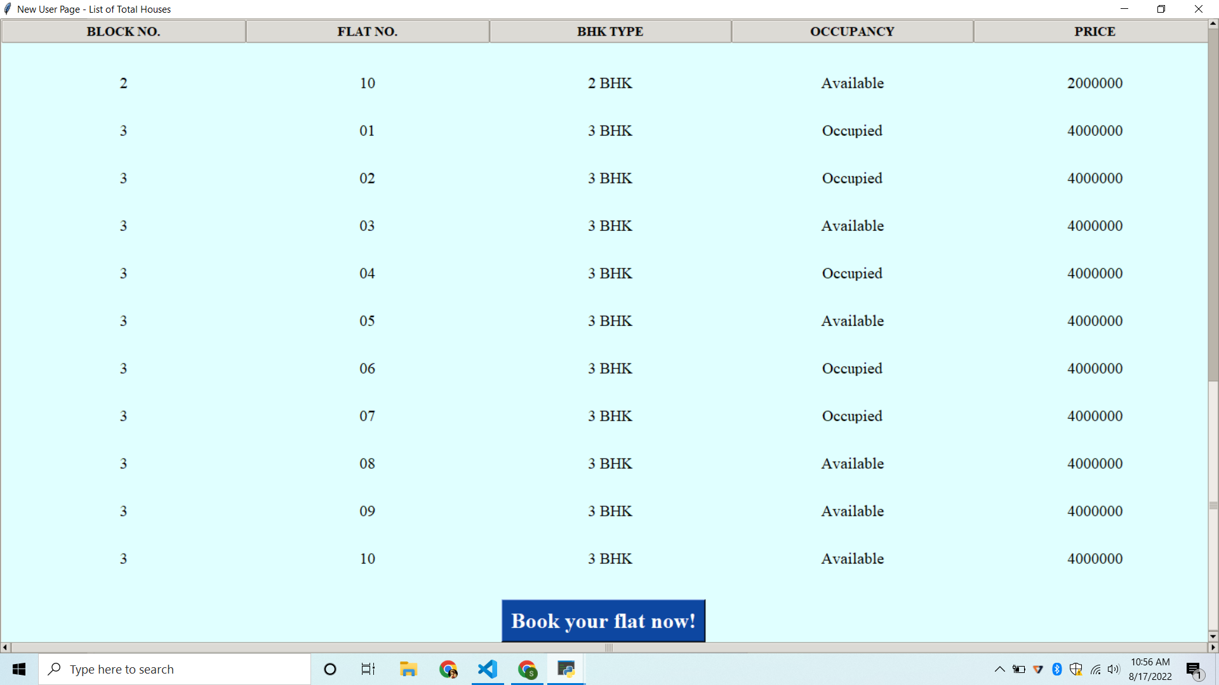

Slide 37
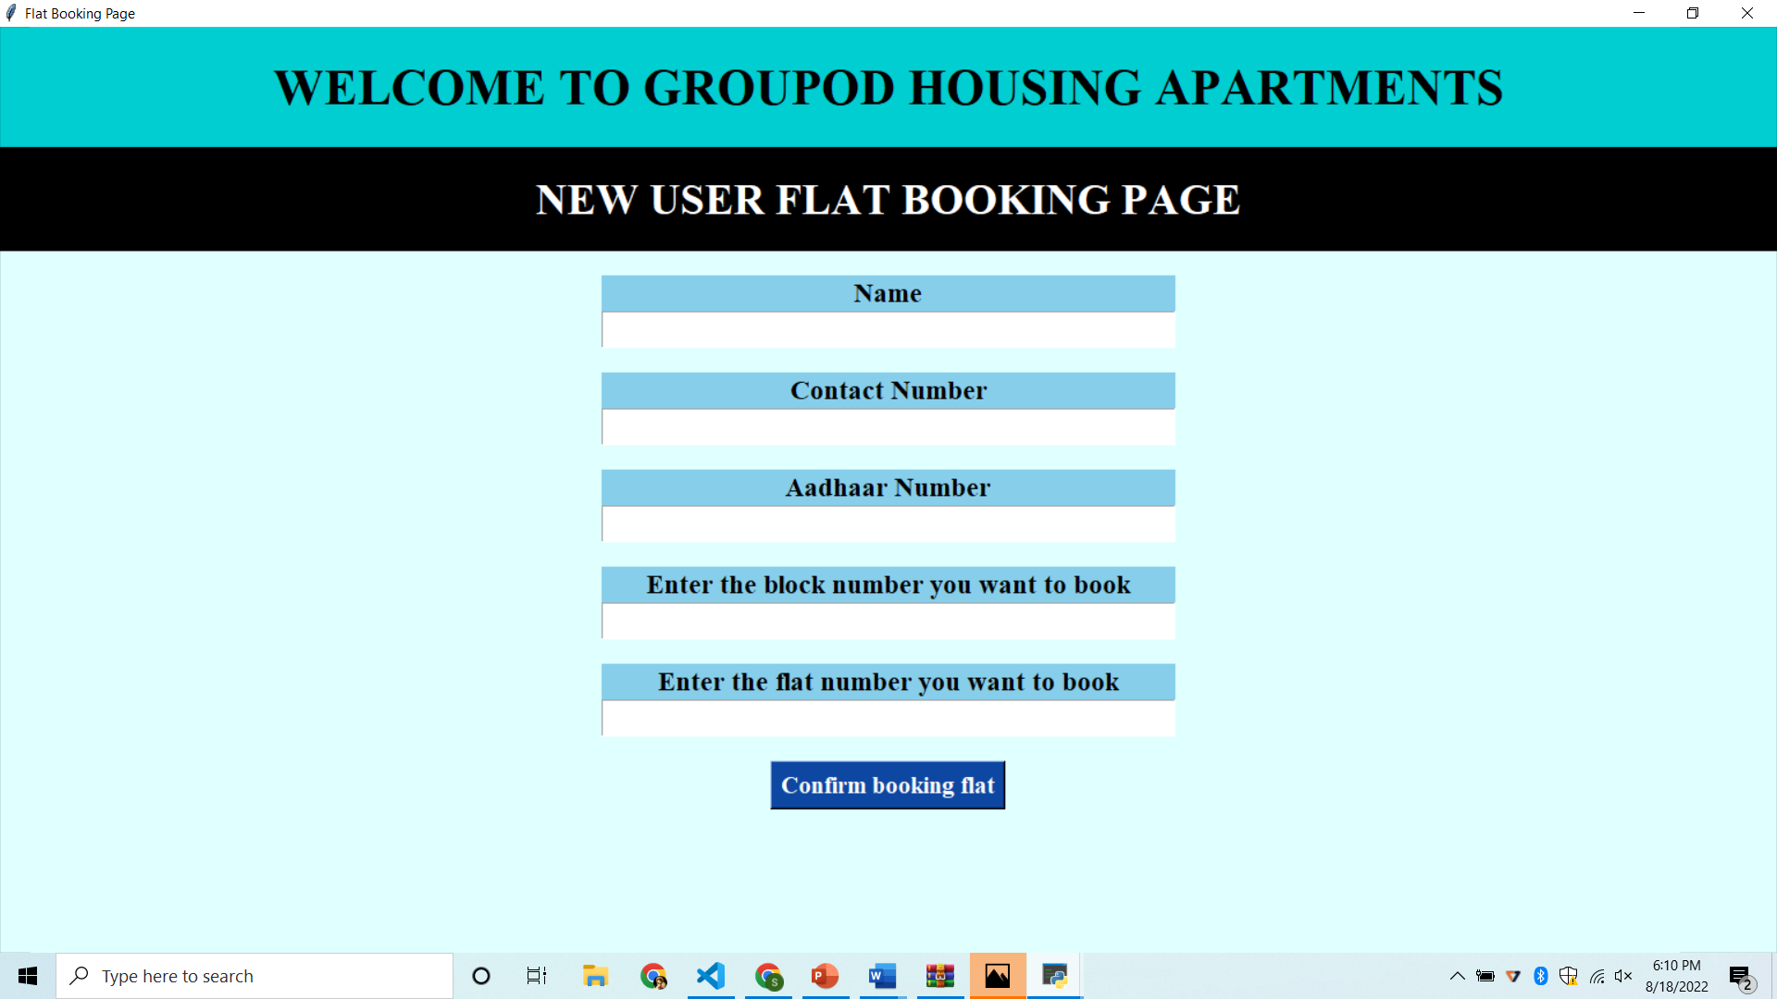

Slide 38
IMPLEMENTATION OF NEW USER MODULE
The new user will be able to either login and see the flat details or book a house if he already has an account.
If he doesn’t have the account, he will be able to create a new account
He can view the details of the flat details, along with BHK type and price of each house depending on the type of BHK
Thus the system can generate a block wise list of flat details which will make it easy for the occupant to book a flat.

Slide 39
JUSTIFICATION
With Python as a backend and Tkinter as the frontend this module was developed.
First we validate the new user’s login and allow the new user to view the flat details in order to book a house
If he doesn’t have an account, he’ll be asked to create an account based on the rules displayed on the screen
Then the user will be asked to enter his details like phone number, aadhaar number, name, flat number, block number in order to book a new flat.
Here we’ve used tkinter’s module named Treeview tkinter to establish a table with all the required content.

Slide 40
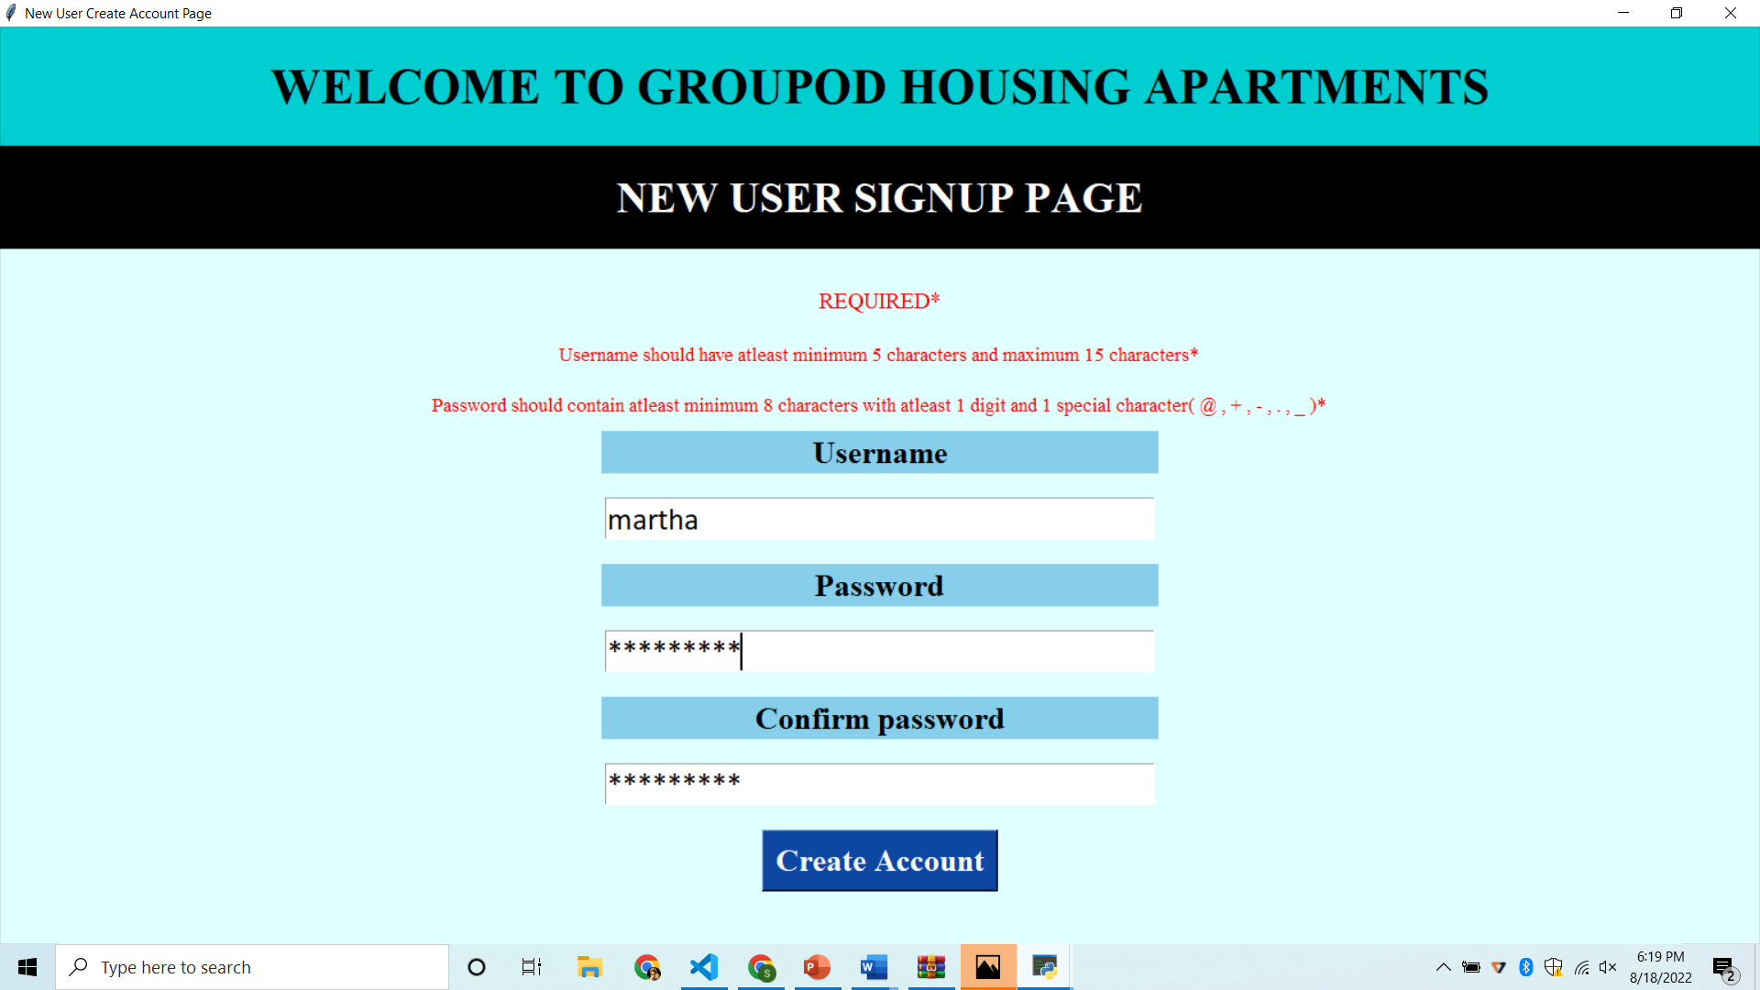
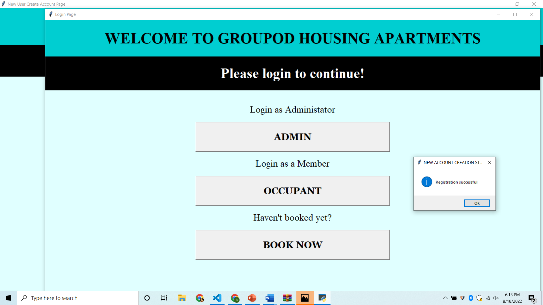
Test case - New User Account Creation
Passed
If entered username is incorrect and password is correct - A window showing a pop-up message “Registration successful” is popped up

Slide 41
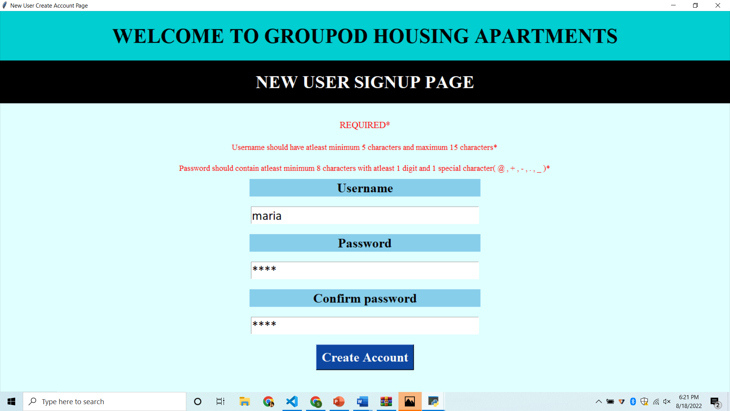

Test case - New User Account Creation
Passed
If entered password is less than 8 characters & only alphabets - A window showing a pop-up message “Invalid Password!” is popped up

Slide 42
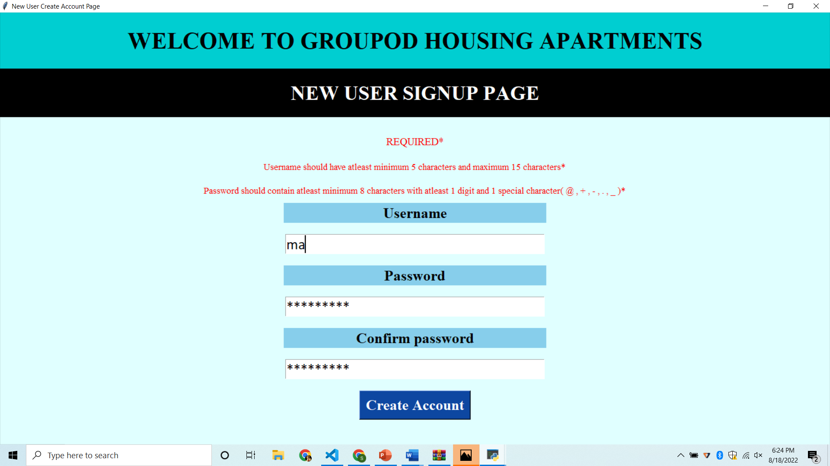
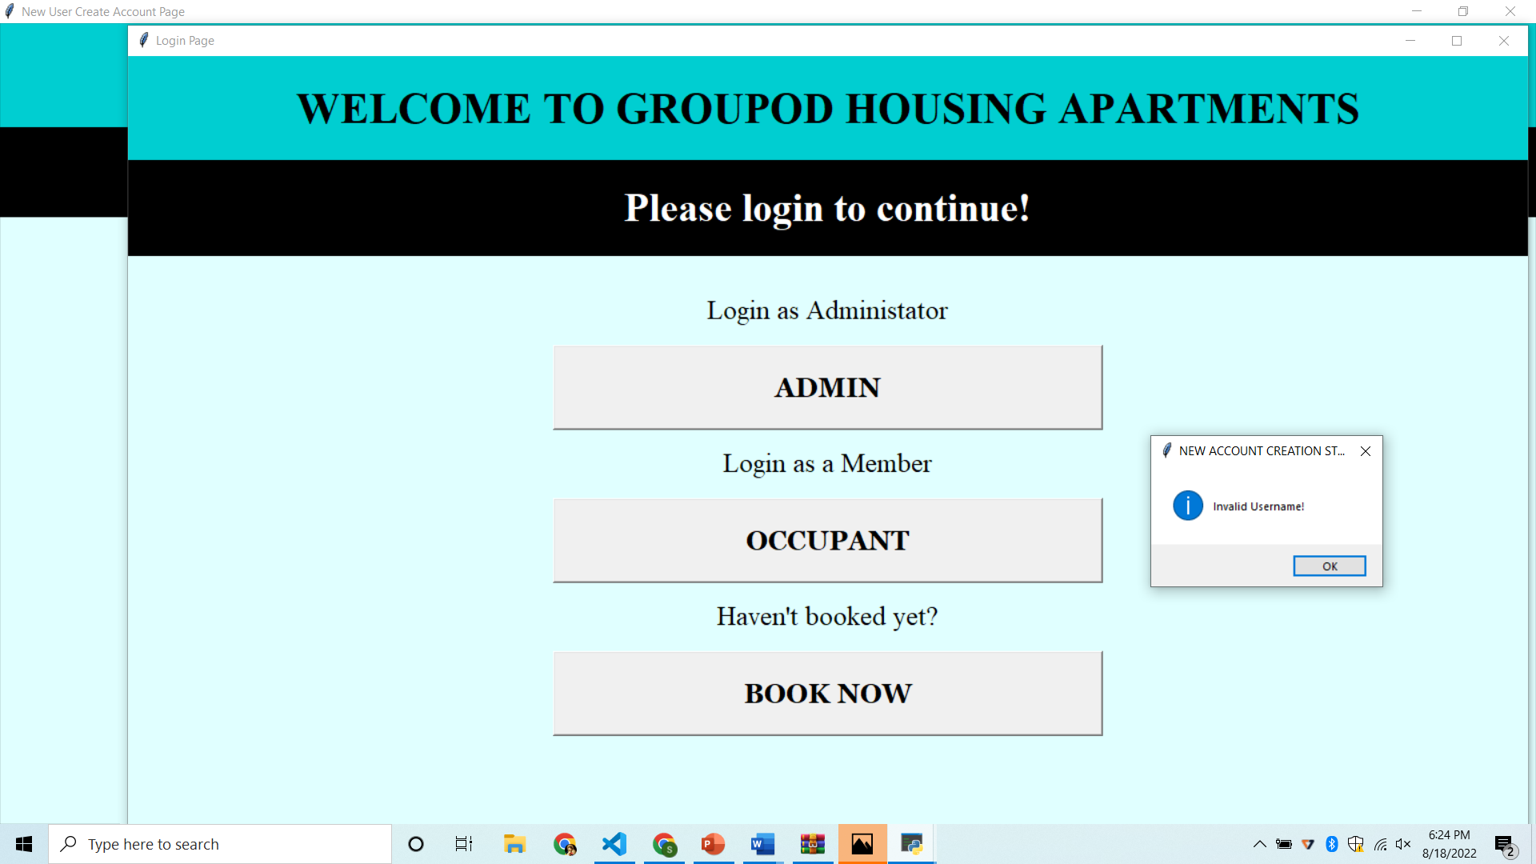
Test case - New User Account Creation
Passed
If entered username is less than 5 characters - A window showing a pop-up message “Invalid Username!” is popped up

Slide 43

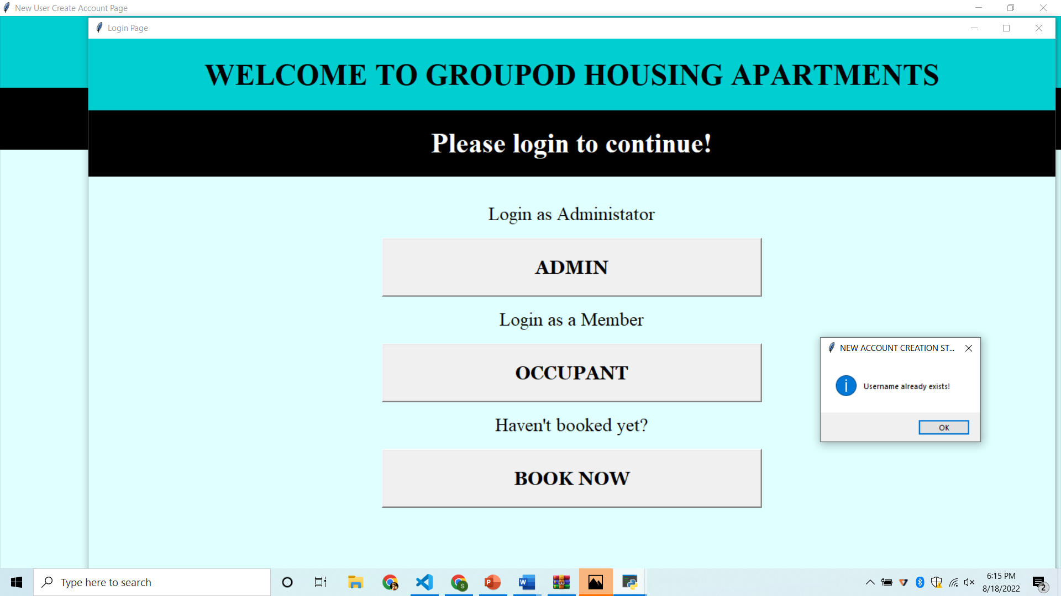
Test case - New User Account Creation
Passed
If entered username and password is already existing - A window showing a pop-up message “Username already exists!” is popped up

Slide 44
TEST CASES - OVERALL PROJECT
1 | Successful User Verification | The login to the system should be tried with the login assigned by the admin and the correct password | Login should be successful and the user should enter in to the system | Passed
2 | Unsuccessful User Verification due to wrong password | Login to the system with a wrong password | Login should fail with an error ‘Invalid Password’ | Passed
3 | Unsuccessful User Verification due to invalid login id | Login to the system with a invalid login id | Login should fail with an error ‘Invalid user id’ | Passed
4 | Unsuccessful User Verification due to wrong password and invalid login ID | System was logged in with both an invalid login id and a wrong password | Login should fail with an error ‘Invalid user id and password’ | Passed
5 | Unsuccessful user verification | System was logged in with the password same as the username | Login should fail with an error ‘Password can’t be similar with your other personal info’ | Passed
6 | Unsuccessful user verification | System was logged in with characters fewer than 8 | Login should fail with error ‘Your password must contain atleast 8 characters’ | Passed
7 | Unsuccessful user verification | System was logged in with a very generic password | Login should fail with error ‘Your password can’t be a commonly used password | Passed

Slide 45
TEST CASES - OVERALL PROJECT
8 | Unsuccessful user verification | System was logged in with password having entirely numeric characters | Login should fail with error ‘Password cannot entirely contain numeric characters’ | Passed
9 | Unsuccessful user verification | System was logged in with username having more than 150 characters | Login should fail with error ‘Username should contain 150 characters or fewer’ | Passed
10 | Unsuccessful user verification | System was logged in with username containing only letters | Login should fail with error ‘Username should contain atleast 1 Uppercase character, 1 special character’ | Passed
11 | Successful payment operation | The payment was already paid by the occupant | Payment done prompt should appear | Passed
12 | Unsuccessful flat search | The user searched for a flat which is not present in the housing community | Prompt should appear saying “invalid flat entry made” | Passed
13. | Flat searched for maintenance payment is vacant | The user searched for a flat which is vacant for the payment fee | Prompt should appear saying ‘payment not possible flat is vacant” | Passed
14. | Payment option not selected for maintenance fee | The user did not select any payment method for the payment of the maintenance fee | Prompt should appear showing an error | Passed

Slide 46
RISK MANAGEMENT
Risk # | Risk Description | Probability | Impact | Mitigation Plan
1. | TIME CRUNCH | High | High | To overestimate time needed to complete the tasks in the planning phase.
2. | LACK OF CLARITY | Low | Mid | When planning a project, check & recheck your requirements to ensure everything is in space.
3. | COMMUNICATION | Mid | Mid | Don't send 3 paragraph email to Developers, have a call instead.
4. | ABSENTEEISM | Low | Low | An organization should offer a reward program for good attendance.

Slide 47
RISK MANAGEMENT
Risk # | Risk Description | Probability | Impact | Mitigation Plan
5. | POOR SCHEDULING | High | Low | The project schedule must be accessible to every team member.
6. | HEALTH ISSUES | High | High | The team members must be able to cope up in case of any health issues of other team members.
7. | TECHNOLOGY RISKS | Mid | High | Secure computers, servers and wireless networks, use anti-virus and anti-spyware protection, and firewalls, regularly update software to the latest versions, use data backups that include off-site or remote storage, secure your passwords.

Slide 48
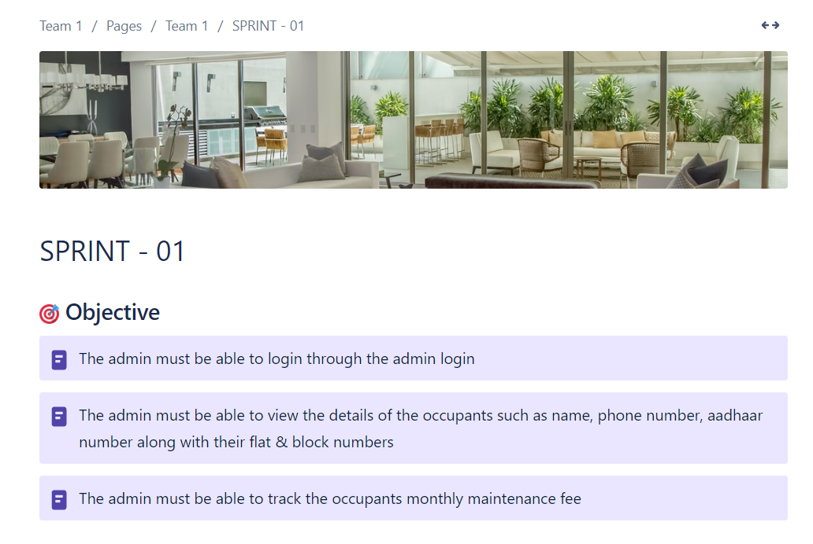
WORKING WITH JIRA TOOL - SPRINT 1

Slide 49
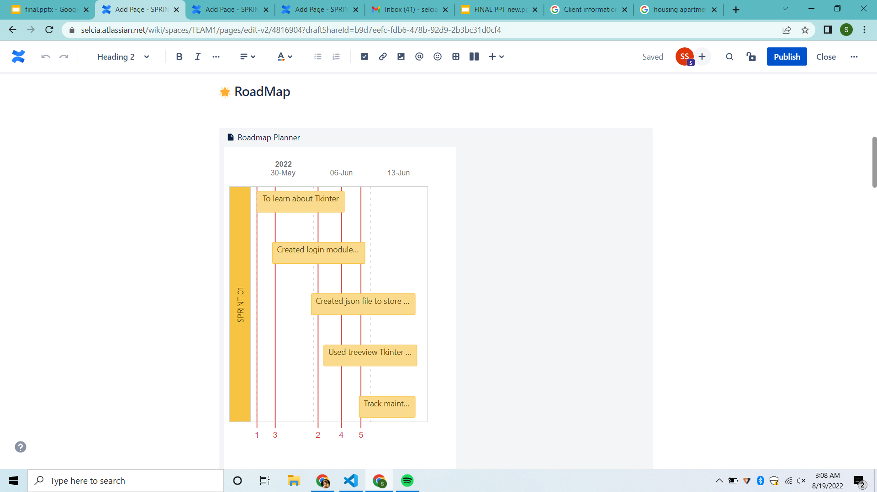
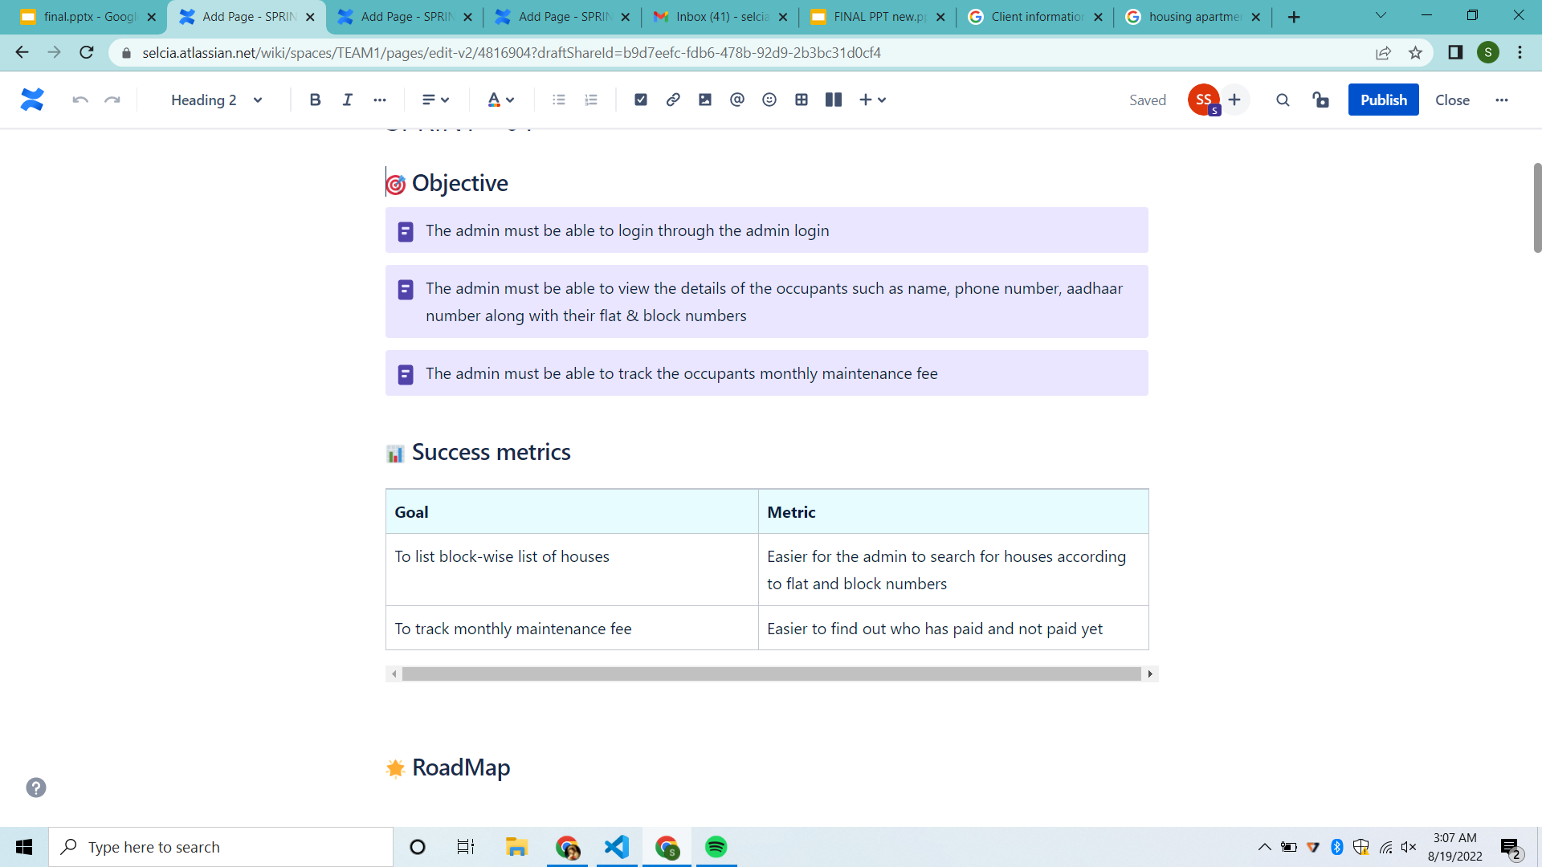
WORKING WITH JIRA TOOL - SPRINT 1
By tracking metrics we can develop better decision-making, resulting in higher team productivity and customer satisfaction.
By the use of roadmap, we can track our work and keep our team members updated.

Slide 50
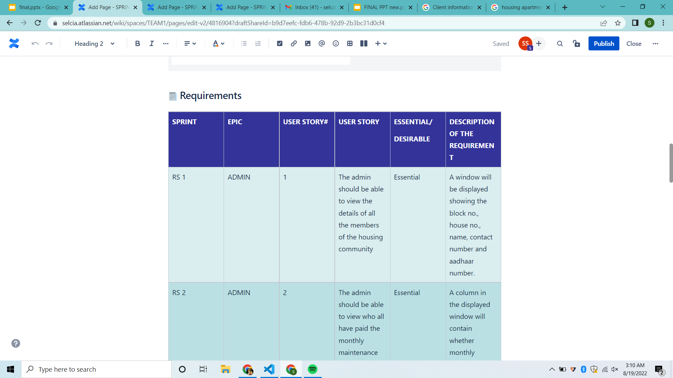
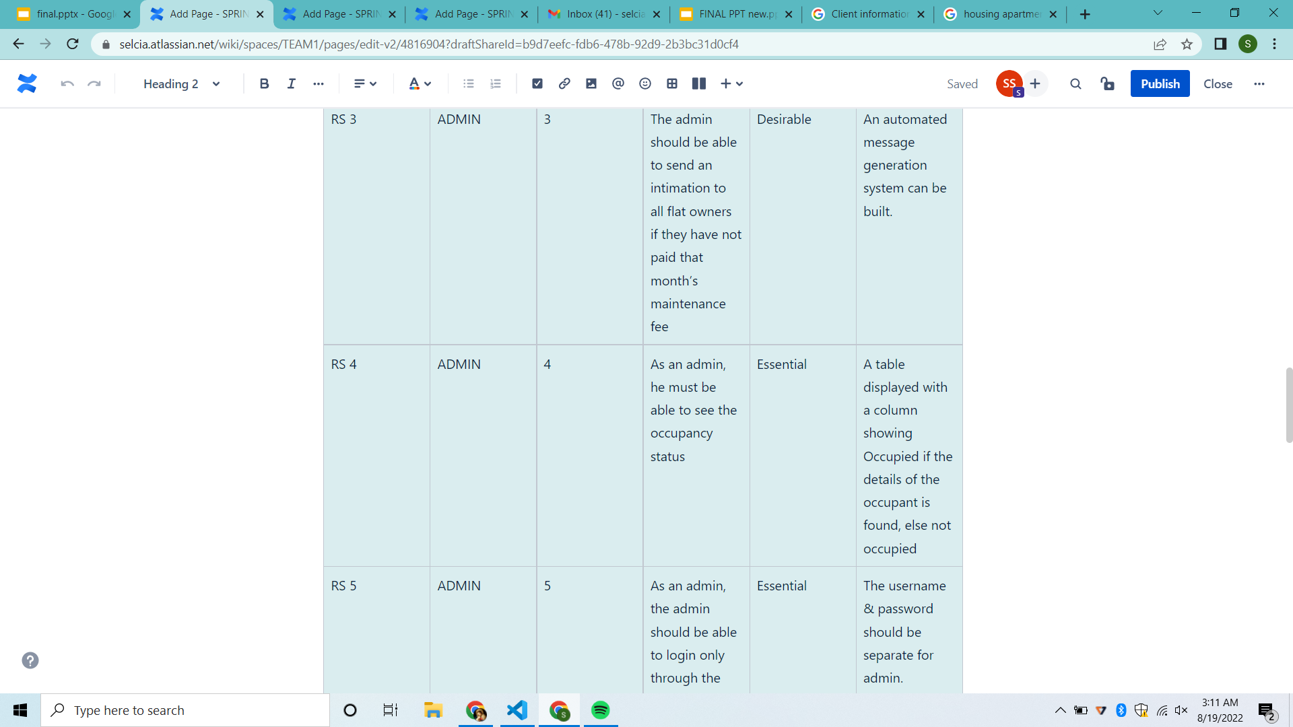
WORKING WITH JIRA TOOL - SPRINT 1

Slide 51
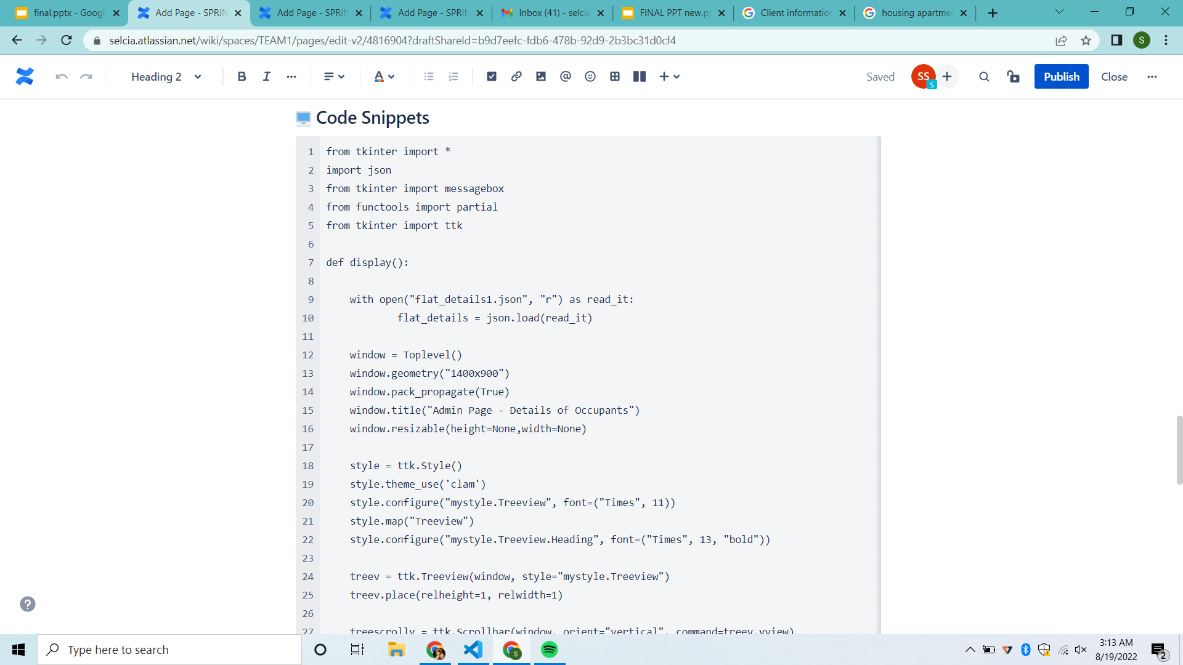
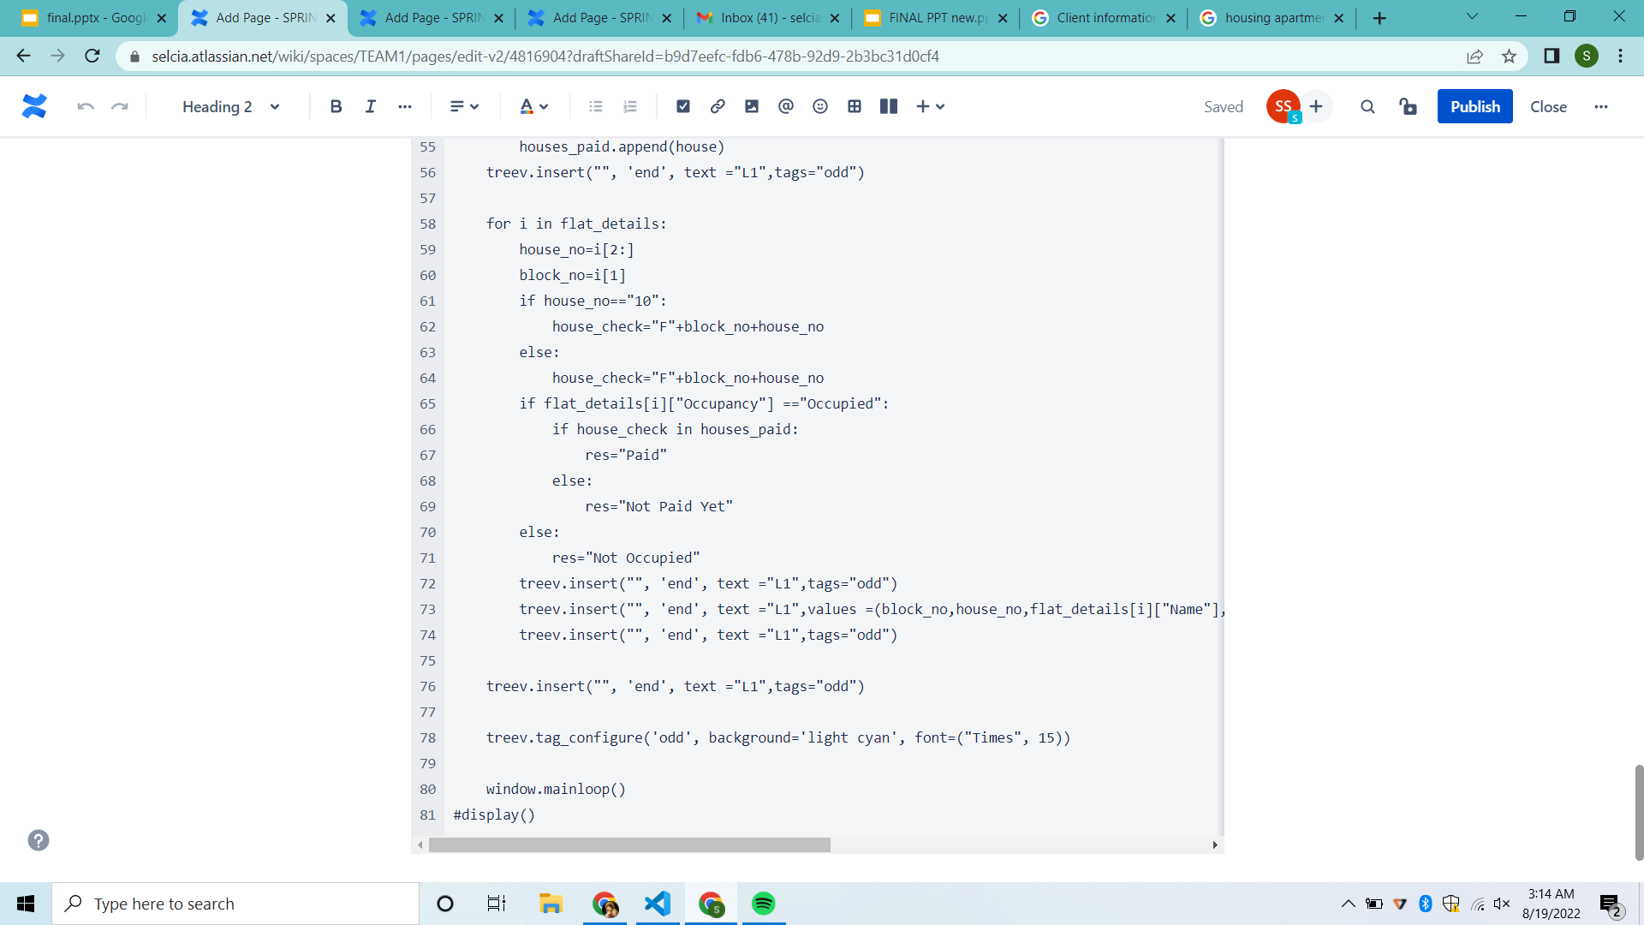
WORKING WITH JIRA TOOL - SPRINT 1

Slide 52
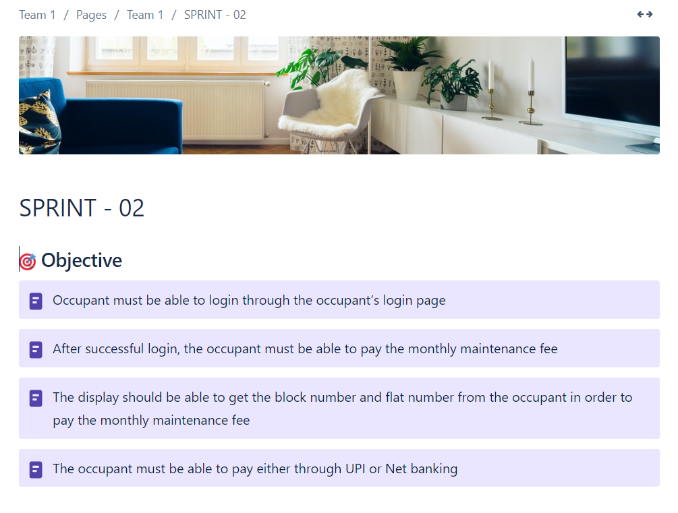
WORKING WITH JIRA TOOL - SPRINT 2

Slide 53
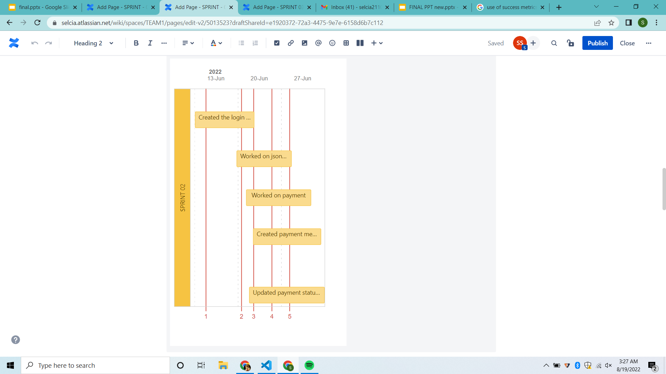
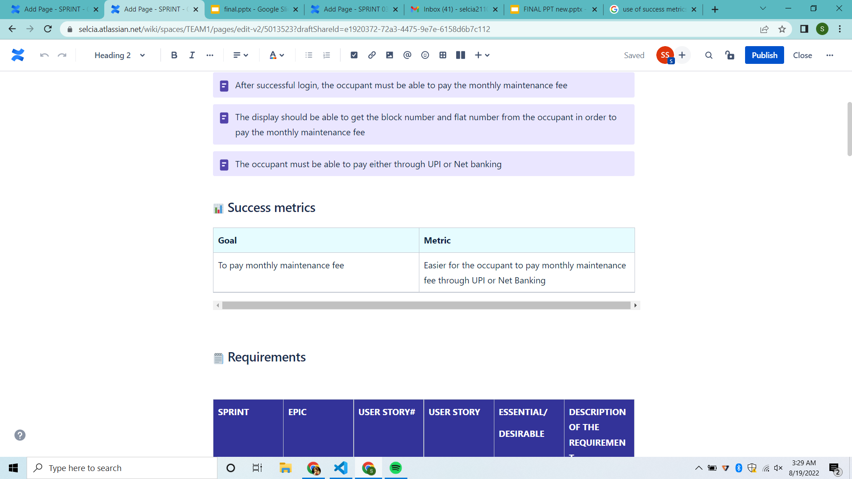
WORKING WITH JIRA TOOL - SPRINT 2
By tracking metrics we can develop better decision-making, resulting in higher team productivity and customer satisfaction.
By the use of roadmap, we can track our work and keep our team members updated.

Slide 54
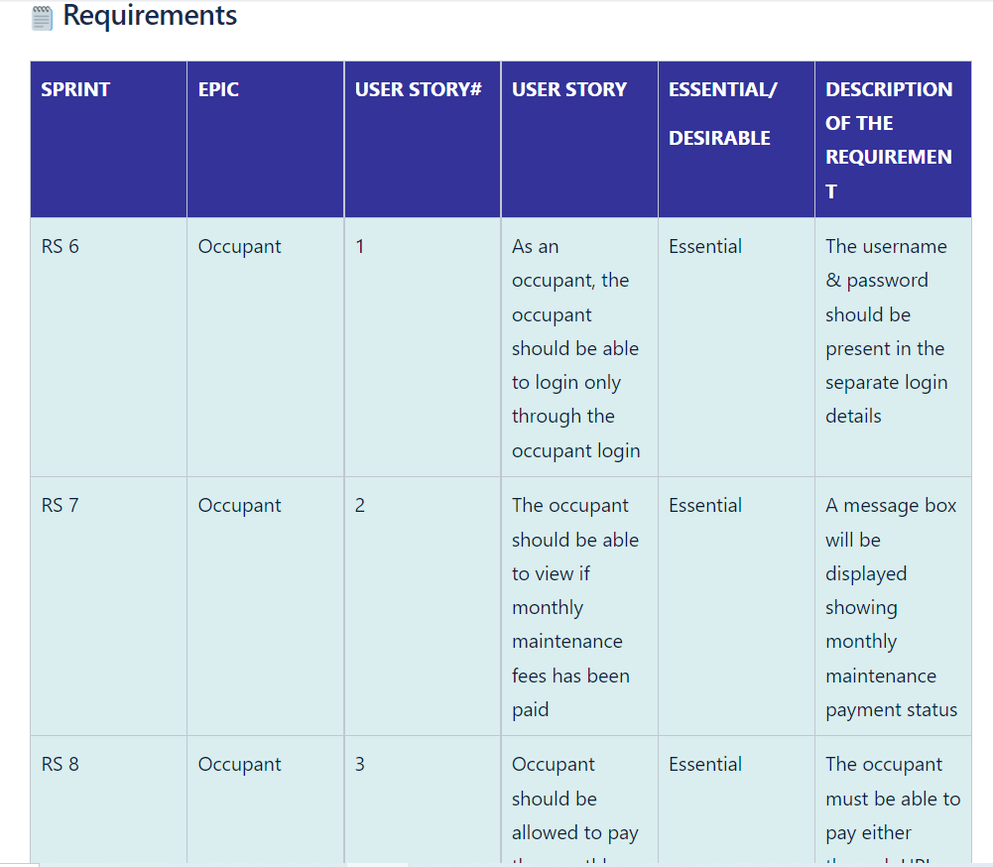
WORKING WITH JIRA TOOL - SPRINT 2

Slide 55
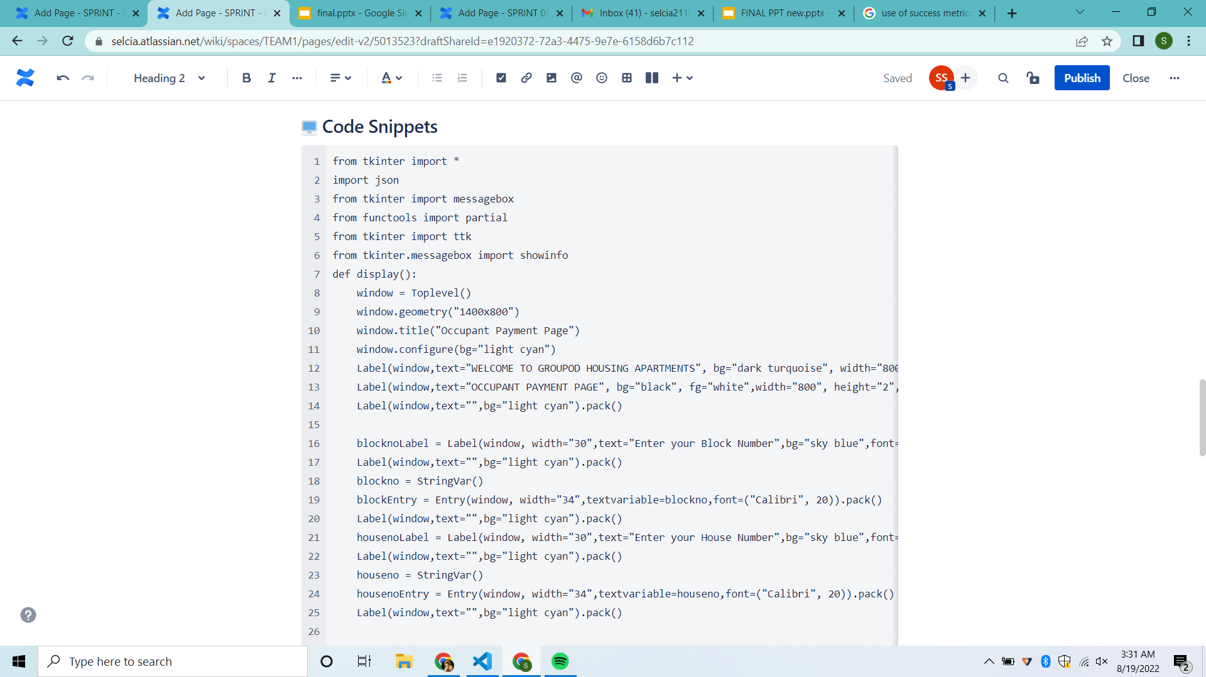
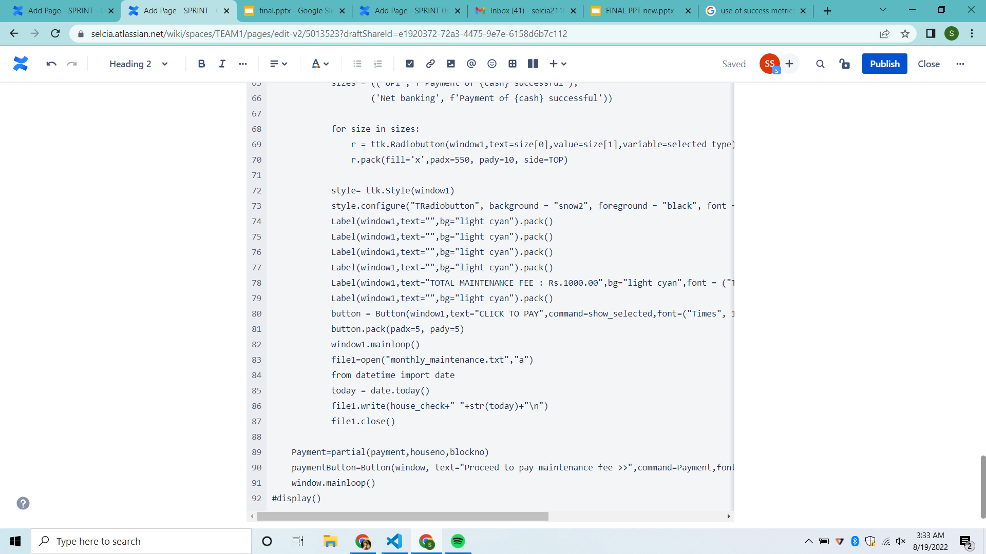
WORKING WITH JIRA TOOL - SPRINT 2

Slide 56
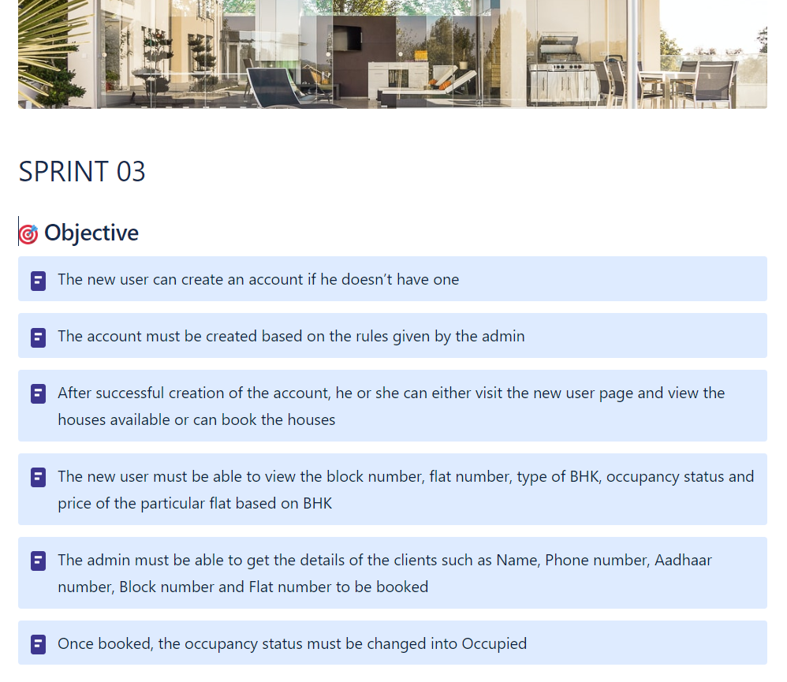
WORKING WITH JIRA TOOL - SPRINT 3

Slide 57
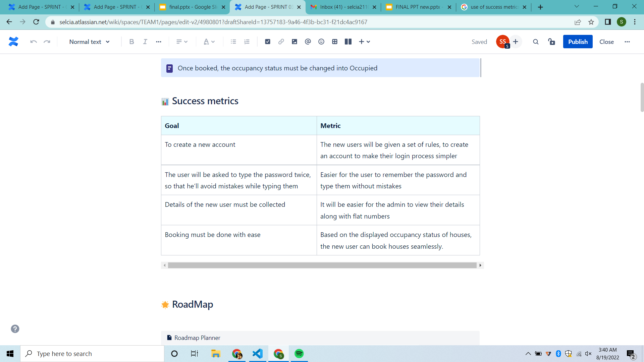
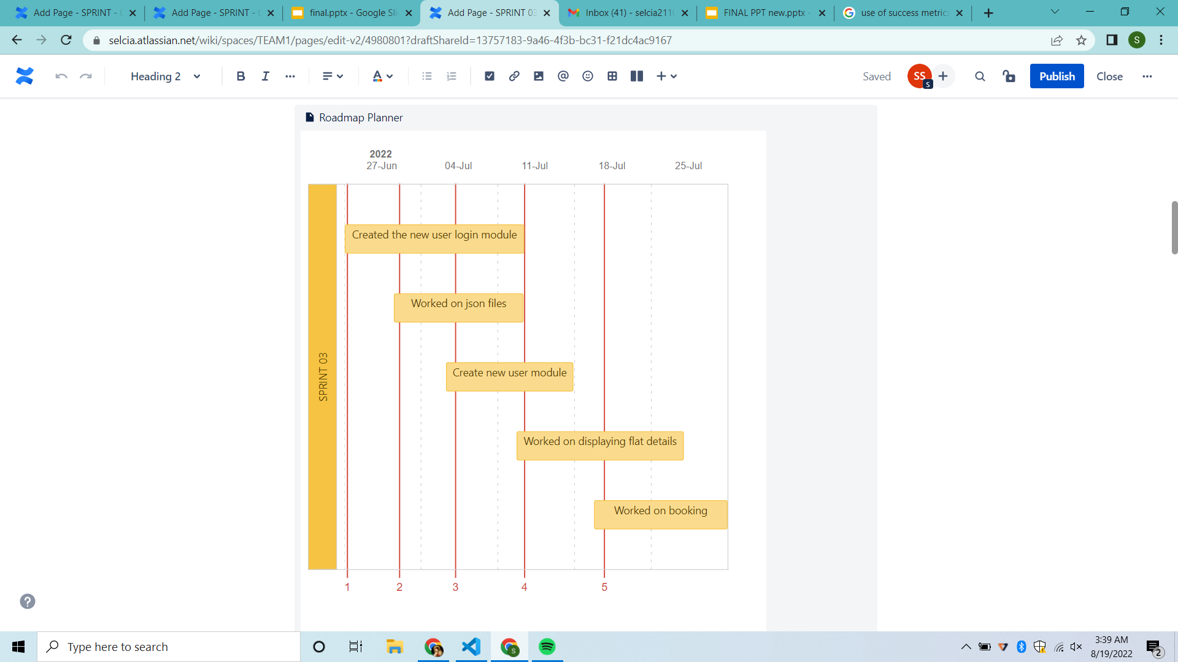
WORKING WITH JIRA TOOL - SPRINT 3
By tracking metrics we can develop better decision-making, resulting in higher team productivity and customer satisfaction.
By the use of roadmap, we can track our work and keep our team members updated.

Slide 58
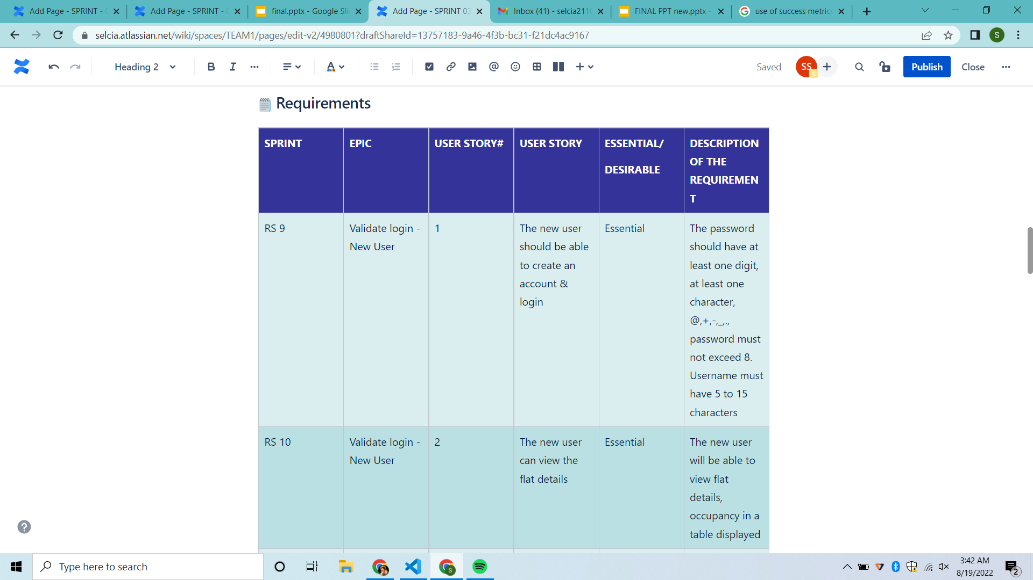
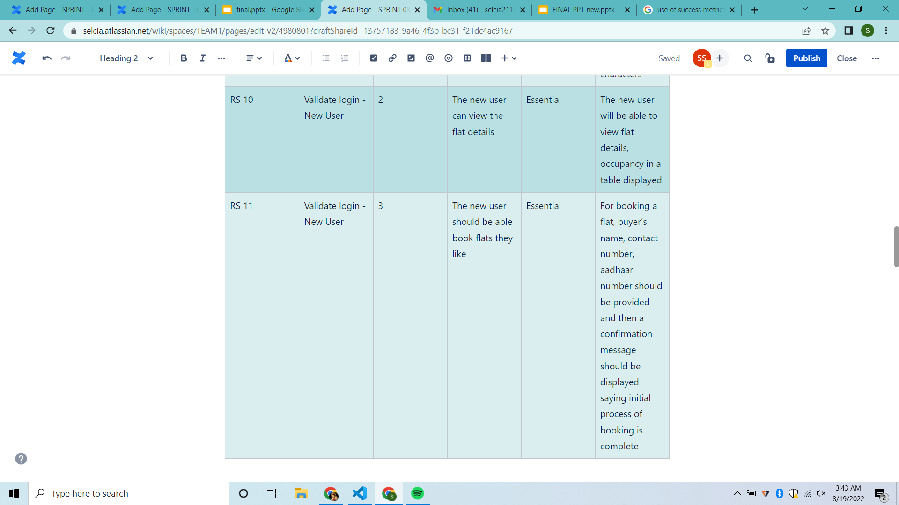
WORKING WITH JIRA TOOL - SPRINT 3

Slide 59
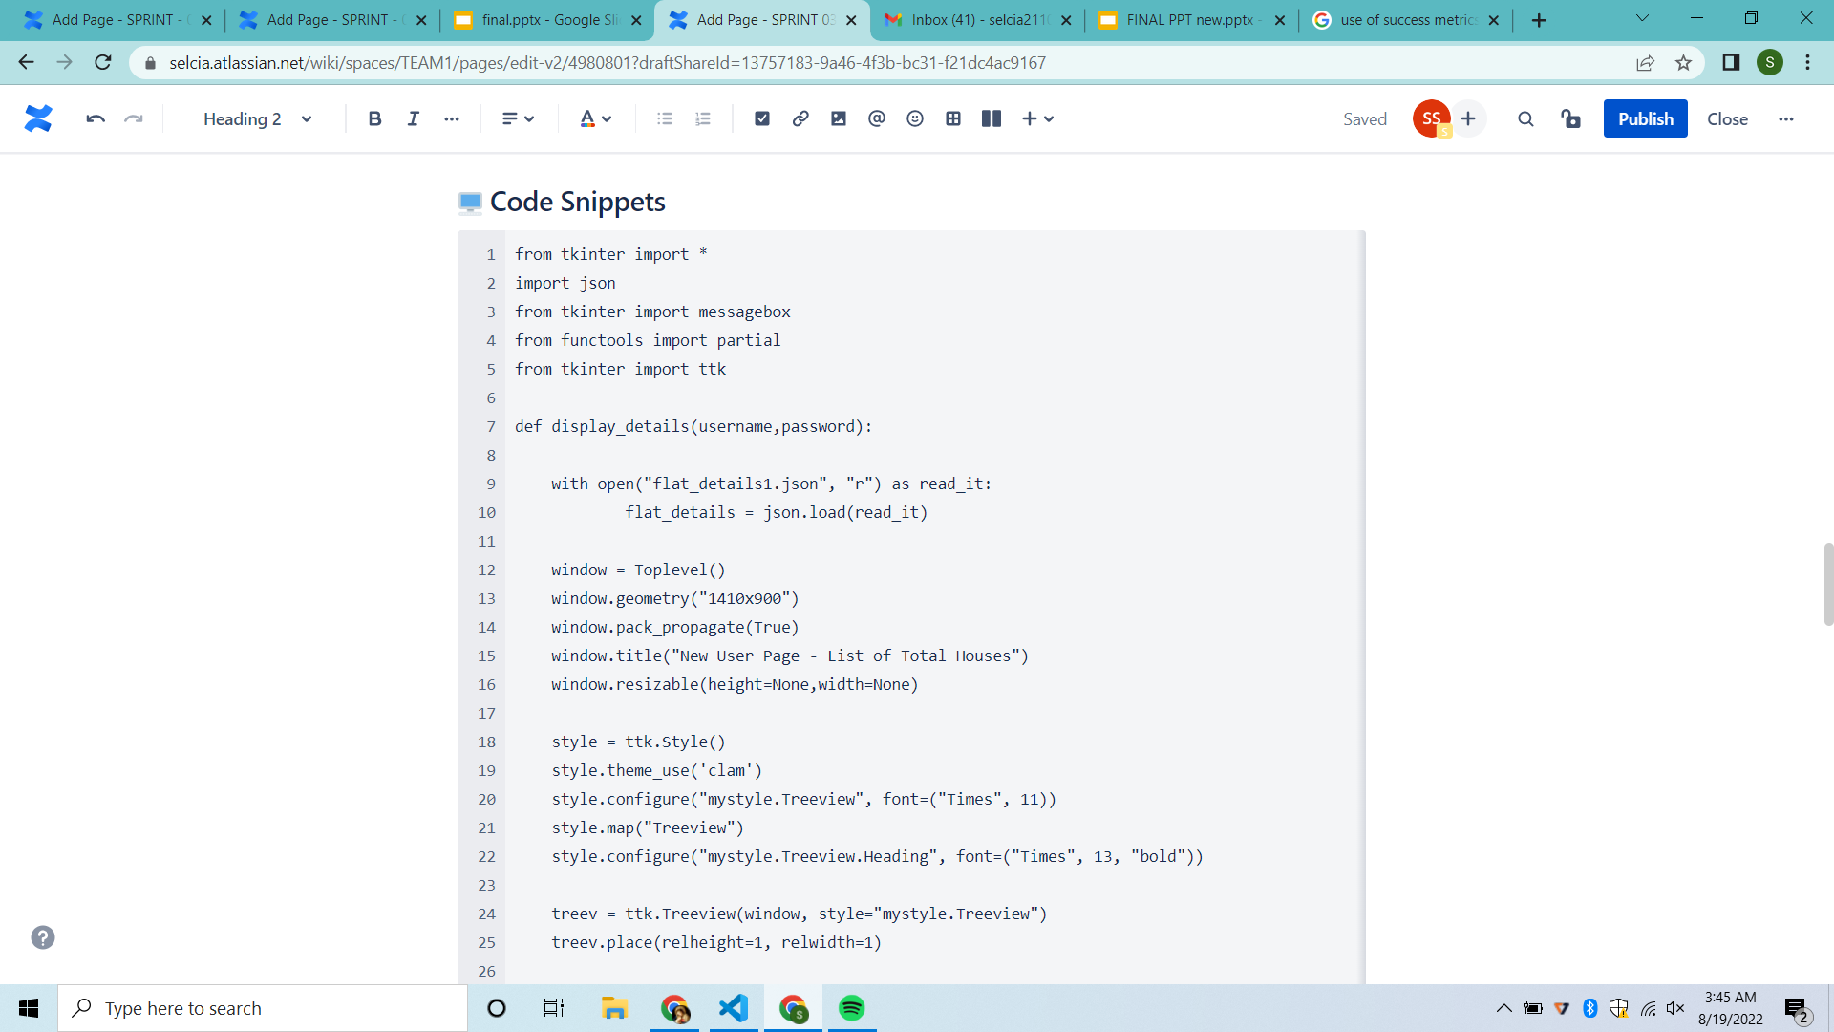
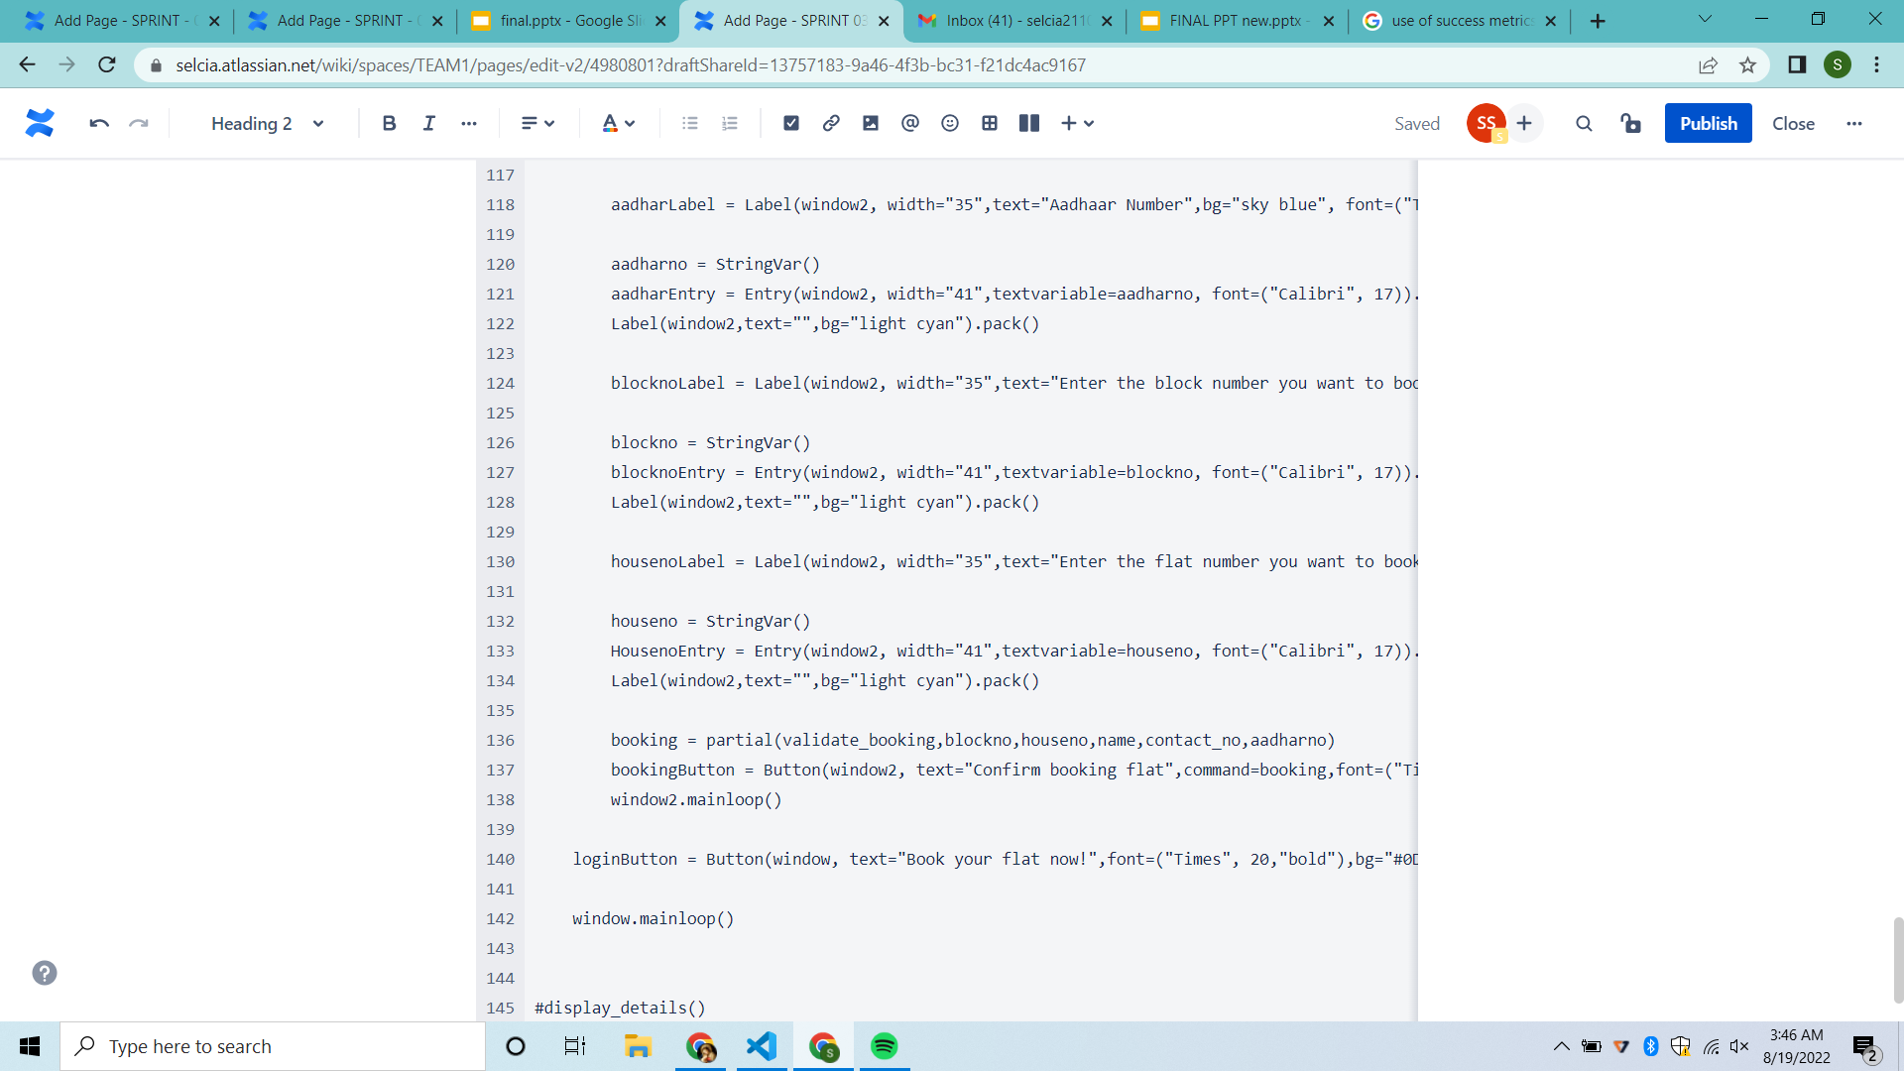
WORKING WITH JIRA TOOL - SPRINT 3

Slide 60
DATA STRUCTURE USED
A dictionary data structure in Python is an unordered collection of items.
While other data structures use only one value as the element, the dictionary is a slightly more compound data structure which makes of two elements i.e. a pair of elements, namely a key and value.
The mapping objects are used to map hash table values to arbitrary objects. In python there is a mapping called dictionary, which is the data structure we have used to store details of flat, occupants, etc in the form of a json file.

Slide 61
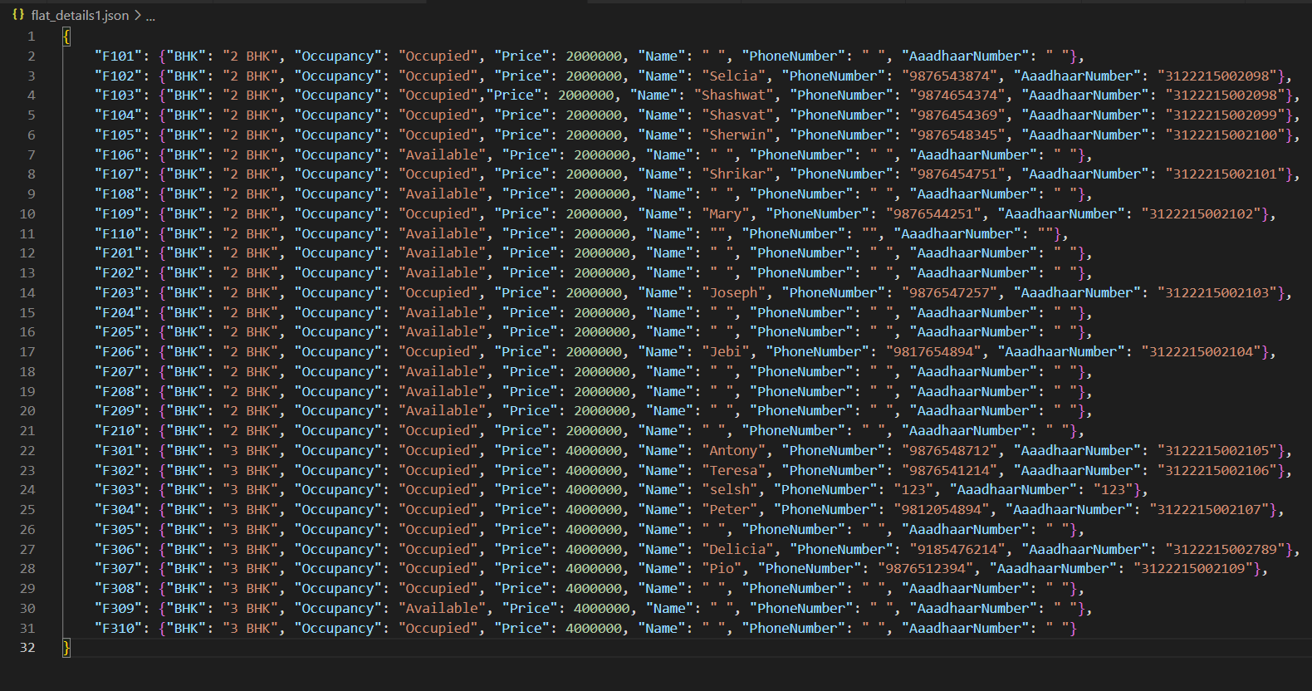
DICTIONARY DATA STRUCTURE

Slide 62
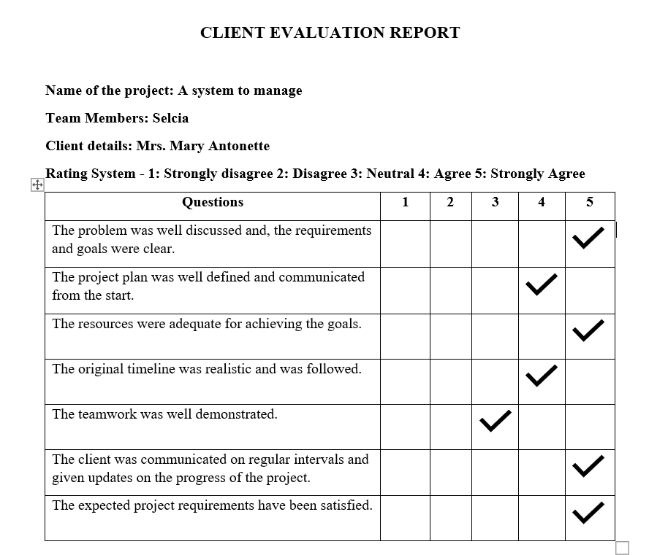
FEEDBACK FROM CLIENTS

Slide 63
REFERENCES
Python Tkinter Tutorial https://www.geeksforgeeks.org/python-tkinter-tutorial/
Python JSON
https://www.geeksforgeeks.org/python-json/
Python
https://www.python.org/

Slide 64
THANK YOU

